Slide 1
Work: | ISA8895 Implementation
Section: | Structure
Chapter: | Knowledge Asset
Language: | English
Version: | V3 - 05/2011

Slide 2
Agenda
Introduction
ISA88 Product Hierarchy Model
ISA88 Equipment Independent Recipe Model
ISA88 PPC representation
ISA95 Operations Model
Practice

Slide 3
CC functional domains
ISA-95
Product Asset Management
Inventory Asset Management
Physical Asset Management
Human Asset Management
IT Asset Management
ISA-88
TOGAF
ITIL
ISA-88 + ISA-95

Slide 4
Information Elements
Domain | Model | Std | Information elements
Product Asset | Product Product | ISA88 ISA95 | Product Hierarchy Product Definition
Inventory Asset | Material | ISA95 | Material Resources
Physical Asset | Physical Equipment | ISA88 ISA95 | Equipment Hierarchy Equipment Resources
Human Asset | Personnel | - ISA95 | Personnel Hierarchy Personnel Resources
Equipment Control | Procedural | ISA88 | Functional Hierarchy Equipment Procedural Elements
Physical Process Control | Procedural | ISA88 | Physical Processes / Procedural Elements Physical Process Transform Components
Physical Process Mngt | Segment | ISA95 | Segments
Operation Process Mngt | Operation Activity | ISA95 | Operation Processes Activities / Tasks

Slide 5
Objective of the Knowledge Asset Modelling
The value of a product is set by the need of the market to own it
Its manufacturing implies the combination of other products and their transformation
The industrial solution to make the product is built on the specification of material combination and physico-chemical transformation required to obtain a congruent product
  It basically defines the value creation stream of the product
  Several « synthesis routes » can be defined
Product Asset Modelling handles this specification that
  Enables the product industrialization
  Decouples the product value creation stream and the operating procedure (See « From Product to Process »)

Slide 6
Objective of the Product Asset Modelling
Product Modelling provides an abstraction of the physical-chemical processing
  It is independent of facilities physical layout and machinery capabilities
  Variant of the same product definition may exist for different sites
It highlights necessary material transformations to obtain the desired product
  The Energy Chain primitive breakdown
It is shared by all parties of the Money and Energy Chains
  Provides a basic, consistent framework for benchmarking manufacturing segment between product, facilities and batches / production runs
  Must correspond to a specific level of Product Segment: bi-directional Design (PLM) / Supply Chain integration

Slide 7
Who’s / What’s concerned?
PRM | Usr/Rsp | Usage | Typ.IT app
Customer order processing | X | Material identification and equivalence
Production planning & scheduling
Production control
Material and energy control
Procurement
Quality assurance | X | Determine quality criteria and protocoles
Product inventory control
Product cost accounting | X | Production costing
Product shipping administration
Maintenance management
Research & development | R | Response to market, industrialize products
Engineering |  | Build/adapt manufacturing facilities
Marketing and sales | X | Market requirements
Finances | X | investment, depreciation, Sarbanes Oxley
Human Resources
Informaiton Technologies

Slide 8
Models Overview
This asset is described in a hierarchical manner
4 models address knowledge asset modelling
  ISA88 Product Hierarchy Model
    Called “Process model” in ISA88
  ISA95 Process Segment model
  ISA95 Operations Definition model
  ISA88 Equipment Independent Recipe Model
    See « From Product to Process »

Slide 9
Agenda
Introduction
ISA88 Product Hierarchy Model
ISA88 Equipment Independent Recipe Model
ISA88 PPC representation
ISA95 Operations Model
Practice

Slide 10
ISA88 Product Hierarchy Model
Addresses to the structural description of the company product knowledge asset
  Hierarchical transformations to obtain a product
Highly flexible, not constraining,
  The hierarchy can be adapted: extended, collapsed, renamed
  The ”Batch taste” terminology can be adapted
  Supports convergent / divergent processes
Independent of the facility
  No relationship with Physical Asset
  Focuses on material transformation / combination
  =/ equipment related operating procedure
  Neutral basis for performance benchmarking

Slide 11
ISA88 Product Hierarchy Model
A sequence of chemical, physical, or biological activities for the conversion, transport, or storage of material or energy.
Process Procedure
Process
Elements
A part of a process that usually operates independently from other process stages and that usually results in a planned sequence of chemical or physical changes in the material being processed.
Process Stage
A major processing activity that usually results in a chemical or physical change in the material being processed and that is defined without consideration of the actual target equipment configuration.
Process Operation
Process Action
Minor processing activities that are combined to make up a process operation.

Slide 12
Process Definition
PROCESS
PROCEDURE
PROCESS
STAGE
PROCESS
OPERATION
The hierarchical sequence of process stages, process operations and process actions that defines an ideal procedure for the manufacture of a successful product.
  Specific rework processes can be defined as separate Process Procedures
Inputs
  Raw materials, purchased products
  Intermediate products
  Energy
Outputs
  Intermediate products
  Co-product, by-products,
  Energy
PROCESS
ACTION

Slide 13
Process Stage
PROCESS
PROCEDURE
PROCESS
STAGE
PROCESS
OPERATION
A major transformation activity / a main product breakdown
  a sequence of process operations = chemical or physical changes in the material being processed
  Independent: produces stable intermediate products
  For the product production information / planning / supervision / process engineering
Definition based on
  Chemistry / Physics
  Logistics
  Engineering
Inputs
  Raw materials, purchased products
  Intermediate products
  Energy
Outputs
  Intermediate products: not necessarily identified from on PS to another
  Co-product, by-products,
  Energy
PROCESS
ACTION

Slide 14
Process Stages definition rules
PROCESS
PROCEDURE
PROCESS
STAGE
PROCESS
OPERATION
Product physico-chemichal status
  Chemical synthesis route
  Main parts manufacturing and main assembly steps
Major transformation
  Obvious change in the nature or shape
Combination / Separation
  Based on convergence/Divergence points
Intermediate
  Independent / Asynchronous / Managed
  Usable for several products
  Can be sold as finished product
  Can be sourced from external vendors
PROCESS
ACTION

Slide 15
Process Stages definition rules
PROCESS
PROCEDURE
PROCESS
STAGE
PROCESS
OPERATION
Target facility
  Common equipment constraints for the process stage
  Alignment on existing Work Center (Process Cell): The Process Stage corresponds to one or several Master Recipes
Intermediate products planning
  Within or separately of the finished product
  Process Stage = Process Procedure for an intermediate
  Planning of an intermediate: the Process Procedure contains the only corresponding Process Stage
PROCESS
ACTION

Slide 16
Process Operations
PROCESS
PROCEDURE
PROCESS
STAGE
PROCESS
OPERATION
A major transformation activity
  A sequence of Process Actions
  Operate in sequence on the material within the process stage
  Irreversible chemical or physical change in the material being processed
  Generally based on chemical or physical considerations
Inputs
  Raw materials, purchased products
  Intermediate products
  Energy
Outputs
  Intermediate products: not necessarily identified from on PS to another
  Co-product, by-products,
  Energy
PROCESS
ACTION

Slide 17
Process Operations definition rules
PROCESS
PROCEDURE
PROCESS
STAGE
PROCESS
OPERATION
Natural organizational structure to identify major processing steps
  Obvious processing steps
  Test and decision points
Alignment to Master Recipes
  Identification of possible operation boundaries for subsequently generated master recipes
Equipment requirements identification for actions within the operation
Supervision requirement
  Long process breakdown
  Finer granularity for manufacturing performance monitoring & benchmark
PROCESS
ACTION

Slide 18
Process Action
PROCESS
PROCEDURE
PROCESS
STAGE
PROCESS
OPERATION
A basic processing activity,
  like grind, cool, heat, delay, test or mix
  Addition or removal of material or energy, setting environment
Process Actions within the operation
  Operate on the defined materials in a defined sequence that may be serial / parallel / contain multiple branches
Inputs / Outputs
  Normally no product related I/O identified for Process Action
    However, Process Actions act on Operation I/O
  Processing Parameters and Processing Data
PROCESS
ACTION

Slide 19
Process Action Rules
Process Actions can be of different types. For example:
  Material addition can be a fixed rate or controlled by a process variable such as a pressure, temperature, or pH
Company specific process actions
  unique company processing capabilities (separation, packaging…)
Industry specific process actions,
  such as catalytic conversions or property state changes.

Slide 20
Agenda
Introduction
ISA88 Product Hierarchy Model
ISA88 Equipment Independent Recipe Model
ISA88 PPC representation
ISA95 Operations Model
Practice

Slide 21
ISA88 Equipment Independent Recipe Model
ISA88 defines 2 categories of recipes
  EIR: Equipment Independent Recipes (General, Site) define how to manipulate materials to make a product
  EDR: Equipment Dependent Recipes (Master, Control) specifies how to control equipment in order to make a product
The Product Hierarchy based EIR
  Describes the processing requirements
    as a flow of material combinations and transformations
  Identifies the produced and incorporated materials, parameters
  Specifies the constraints applicable to the manufacturing equipment – not the equipment itself
  Supports the requirement specification to develop the operating procedure applicable to a particular facility
    Complete, consistent, unambiguous
    Understandable by R&D and engineering, at corporate and local levels

Slide 22
ISA88 Equipment Independent Recipe Model
ISA88 Part 3 Extends the General/Site Recipe description in Part 1
Provide a standard way to maintain and exchange general recipes
  Foreign plants, Contract manufacturing
Developed collaboratively
  Based on shared definition of processing capabilities, material master, equipment constraints
  Within the enterprise and among its partners in manufacturing
  Multiple different control system suppliers, integrators, and consultants

Slide 23
ISA88 Equipment Independent Recipe model
EIR
Recipe
Process
Product hierarchy
“Process model”
Process
Stage
Header
Process
Operation
Formula
Equipment
Constraints
Process
Action
Other
Information
From ISA-88 Part 3 Draft 13

Slide 24
Header
The administrative information in an equipment independent recipe is referred to as the header
May include such items as
  Recipe identification
  Version number
  Product identification
  Product family
  Product grade
  Originator
  Lifecycle state

Slide 25
Formula
Includes
  Process inputs
  Process parameters
  Process outputs
Process inputs and process outputs identify
  Materials and quantities of materials
  Resources and quantities of resources
    (Energy, …)

Slide 26
Formula: Material
Materials used in equipment independent recipes shall be identified by material definitions or material classes as defined in the ANSI/ISA 95.00.01 standard
  Equipment independent recipes do not use material lot definitions
Material definitions and material class definitions should be maintained in a material definition library to ensure that only valid material definitions are used in equipment independent recipes
A material definition shall have an associated lifecycle state

Slide 27
Formula: Relationship with the Inventory Asset Model
A material can correspond to an output of a particular Process element
  A finished Product is the result of a Process Definition
  An intermediate can be the result of a Process Stage or possibly of an operation
Product Hierarchy level as Material Classes
  Process Definition / Stage / Operation can be value for the class “ProductHierarchyLevel” = ProcessDefinition / ProcessStage / ProcessOperation
Product Hierarchy level as Material Property
  Process Definition / Stage / Operation can be value for the Property “ProductHierarchyLevel” = ProcessDefinition / ProcessStage / ProcessOperation

Slide 28
Formula: Parameter
Correspond to ISA-95 Operations segment parameters

Slide 29
Equipment Constraints
Equipment Constraints are a statement of the specific requirements of the final manufacturing equipment necessary to bring about the process activities
May also document certain important attributes to select the suitable equipment needed in this process
Used when the equipment properties may impact the chemistry or physics of production
Used to define “hints” to manufacturing where R&D knows the properties of the material will cause problems if not carefully handled
Equipment constraints correspond to ISA-95 Equipment specification properties in ISA-95 Operations segment model

Slide 30
Example of Equipment Constraints
Constraint
Description
Constraint Type
ExternalHeatingCoils
Specifies if any heating coils are external to the containing vessel, so they cannot be fouled by the batch material.
TRUE or FALSE
LiningGlass
Specifies if the containing vessel is glass lined and connecting pipes are Teflon lined.
TRUE or FALSE
LiningNickelFree
Specifies if the containing vessel and pipes are free of any elements containing nickel.
TRUE or FALSE
TransfersShort
Specifies if any transfers between vessels are short, so that unintended reactions (such as crystallize) will not occur in the piping.
TRUE or FALSE
TransfersStraight
Specifies if any transfers between vessels are relatively straight, so that highly viscous or material prone to plugging may be transferred.
TRUE or FALSE
AgtitationNonSheared
Specified that the agitation method does not shear the batch material.
TRUE or FALSE

Slide 31
Other Information
A general recipe is a container of production information required for manufacturing, but it may also contain information for other business activities
Examples of other information that might be included with equipment independent recipes are:
  Spreadsheets detailing known process sensitivity models
  Complete process models
  Pictures of good products
  Pictures of bad products and possible failure reasons
  References to Test Methods & Test Specifications
  References to material data safety sheets
  Additional health and safety information
  Packaging information

Slide 32
Process Action Information
PROCESS
PROCEDURE
PROCESS
STAGE
PROCESS
OPERATION
Process Action is the most detailed Process Element
  Its definition is critical for linking R&D to Process Engineering
    Product Definition to ⬄ manufacturing capabilities
    Basis for optimizing the transformation of the product definition into executable operating procedure / Recipe
Information elements:
  Functionality resulting from its realization
  Parameters to modify its behavior
  Information resulting from its execution
  Environment conditions for its execution
  Pre-conditions for its correct execution
  Post-conditions resulting of its execution to be taken into account
  Known Exception conditions
  Handling of these exception conditions
PROCESS
ACTION

Slide 33
Classes Of Process Actions
PROCESS
PROCEDURE
PROCESS
STAGE
General actions deal with
  Adding materials
  Removing materials
  Adding energy
  Removing energy
  Setting the environment (pressure, agitation…)
PROCESS
OPERATION
Company specific actions may deal with unique
  Material preparation
  Material extraction
  Material shaping
  Material packaging
  Material testing
PROCESS
ACTION

Slide 34
Examples – Adding Material
PROCESS
PROCEDURE
PROCESS
STAGE
PROCESS
OPERATION
Process Action | Functional Description | Parameters
Charge | Add the specified material. There is no rate constraint on the material addition. Usually used where there is no expected chemical reaction. | Material To Add Amount to Add
ChargeAtRate | Add the specified material at the specified rate and tolerance. Usually used when mixing is required or too fast a rate will cause an undesired chemical reaction. | Material To Add Amount to Add Percent Per Minute % / Minute Tolerance
ChargeAtTemperature | Add the specified material so the temperature of the material being produced stays within the specified value. This can require heating or cooling capability. Usually used when an exothermic or endothermic chemical reaction will occur. | Material To Add Amount to Add Maximum Temperature Minimum Temperature Temperature Tolerance
PROCESS
ACTION

Slide 35
Examples – Removing/Separating Materials
PROCESS
PROCEDURE
PROCESS
STAGE
PROCESS
OPERATION
Process Action | Functional Description | Parameters
Dry | Dry the material to remove any water or other safely evaporated materials. | Material To Remove Expected Amount Removed Minimum Temperature
Evaporate-Solvent | Remove a solvent through evaporation. The solvent is to be retained and not dispersed into the atmosphere. | Material To Remove Expected Amount Removed Evaporation Temperature
Filter-Solids | Remove solids. | Material To Remove Expected Amount Removed
PROCESS
ACTION

Slide 36
Examples – Adding Energy
PROCESS
PROCEDURE
PROCESS
STAGE
PROCESS
OPERATION
Process Action | Functional Description | Parameters
Heat | Induce energy to flow into the material. | Final temperature
HeatProfile | Control the rate at which energy is added to the material. There can be one or many sets of parameters for different profiles. | Rate to heat Holding temperature Holding time
PROCESS
ACTION

Slide 37
Equipment Independent Recipe Object Model
Why,
  Because users wanted a standard way to maintain and exchange general recipes
  To foreign plants
  To contract manufacturing
  To multiple different control system suppliers, integrators, and consultants
The model
  Does not define attributes
    But it was enough to define a B2MML/BatchML XML exchange
  Overlaps with ISA95 Product Definition Model
    More dedicated, using ISA88 vocabulary

Slide 38
EIR Object Model
Equipment
Requirement
Library
Process
Element
Library
Equipment
Independent
Recipe
Material
Definition
Library
Is made
up of
Is made
up of
Has a type of
Is made
up of
1..N
1..N
Is made
up of
1..N
Equipment
Requirement
Element
Process
Element
Specification
General
Recipe
Site
Recipe
Material
Definition
1
1
1
0..N
Corresponds
to↑
1
1
Corresponds
to ↑
←May be derived from
1
0..N
0..N
0..N
0..N
0..N
0..N
Process
Procedure
Other
Information
Process
Parameter
Process
Input
Process
Output
Corresponds
to ↑
Corresponds
to ↑
Is made
up of
0..N
0..N
0..N
0..N
0..N
1..N
Has→
Equipment
Requirement
Process
Element
0..N
0..N
← Has
0..N
1..N
0..N
1..N
↓Uses % of
the input
↓ Produces % of
the output
1
1
Process
Element Link
Has a
type of
Percent
Input
Percent
Output
Process
Stage
1..N
Process
Operation
1..N
Process
Action
Is made
up of
Is made
up of
From ISA-88 Part 3

Slide 39
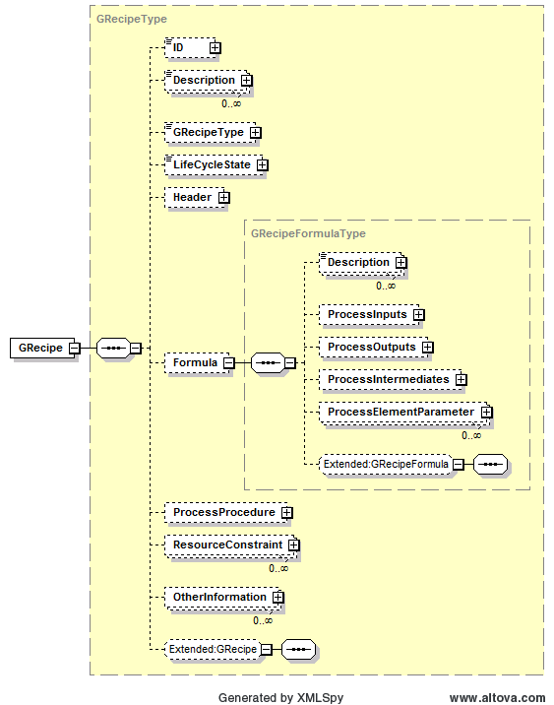
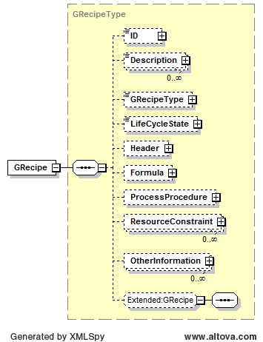
B2MML/BatchML implementation

Slide 40
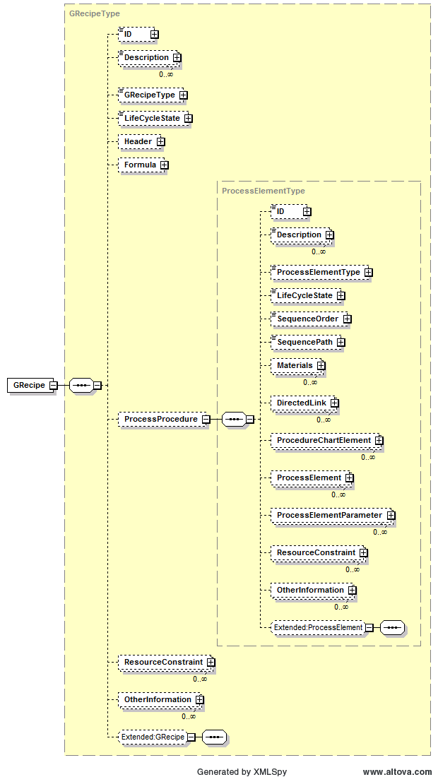
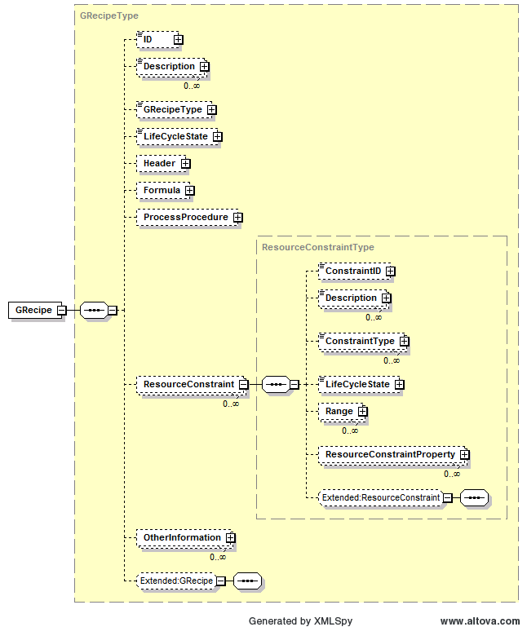

Slide 41
Handling General Recipe definition
Develop a standard corporate library of General Recipe elements
  Material Definition
  Equipment requirement definitions
    These define what will be expected in final manufacturing equipment
    Each site can use this to determine how “capable” they are to meet R&D requirements
    They describe to manufacturing sites exactly what equipment requirements will be asked for in production
  Process actions definitions
    Have manufacturing site determine its best manufacturing processes for each process action
    These are used when creating master recipes
    They describe to manufacturing sites exactly what processing they will be asked to perform to make products
  They define a common language and provide a “contract” between manufacturing and R&D
Define all general and site recipes based on these standard definitions
  Provide document management and change management of the definitions

Slide 42
Summary
General and site recipes follow the same model as master recipes
  Except they define a process not a procedure
The standard includes guides to help identify the recipe elements (process stages, process operations, and process actions)
Use of general and site recipes requires, as a minimum, libraries of process actions, materials, and equipment requirements
Result will be faster and more reliable technology transfers

Slide 43
Agenda
Introduction
ISA88 Product Hierarchy Model
ISA88 Equipment Independent Recipe Model
ISA88 PPC representation
ISA95 Operations Model
Practice

Slide 44
Equipment Independent Recipe Representation
Required within a company to standardize how they represent product definitions
  Few companies have standard, formal, and unambiguous ways to describe pilot plant or R&D instructions to manufacturing
ISA88 Part 3 defines the minimal representation method,
  Graphical and table views defined
  PFC for Process Function Chart

Slide 45
General Recipe PPC
(Process Procedure Chart)
7
Process Input representation
(Material)
Oxidation
Nitration
13
8
22
2
Recipe annotation
Process Note:
Make sure that process temperature is maintained between ring expansion and hydrolysis
Ring
Expansion
55
1
Intermediate Material representation
12
Hydrolysis
Stage , operation, or action representation
10
2
Process Output representation
(Material)

Slide 46
Graphical Recipe Representation
Use the material flow “PFC” notation within a Procedure Diagram
Use SFC like notation within a Process Operation Diagram
Procedure
Diagram
Process Stage
Diagram
Process Operation
Diagram
add
M7
wait
Premix
Charge operation
M7
M8
3
add
Sterilize
M8
2
8
add
heat
wait
mix
Heat
wait
add
hold
M9
9
2
add
M9
analyze

Slide 47
Stage, Operation, and Action Graphical Representation
Rectangle represents a process stage, a process operation, or a process action
The rectangle may be annotated
  An identification
  The number of underlying elements
  The number of equipment requirements
Name
Stage, Operation, or Action Name
Stage, Operation, or Action Representation
nn
nn
12
Indication on Underlying Elements
04
Equipment Requirement Indication

Slide 48
Material Representation
Materials are identified by arrows (directed lines) or arrows with circles
Process Input Representation
Any material may represent more than one material, with the addition of number inside the circle
12
Intermediate Material Representation
Process Output Representation
Unidentified intermediate material

Slide 49
Material Annotation
Materials may be annotated with the material ID
May be annotated with material ID and selected properties
Material ID ABC435
Nominal pH 6.3
Color Pale Yellow
Density 1.42
ABC101
Material ID XGH435
Nominal pH 7.0
Color Yellow
Density 1.35
DEF202
GHI303

Slide 50
Diagram Annotation
Diagrams may also be annotated
May be used to include additional process, equipment, or other information of importance
If a process annotation is used then the annotation shall be associated with an object or with the encapsulating process definition.
Process Note: If the mixture turns bright red, then the process temperature was to high and the material must be discarded.
Process Note: Make sure that process temperature is maintained between ring expansion and hydrolysis

Slide 51
Process Operation Diagrams
Process Operation diagrams show Process Actions
These are assumed to operate on the same material
They need to show parallel and sequential actions
  Similar structure to an SFC
  (IEC 61131-3 Sequential Function Chart)
  Similar structure to a PFC
  (IEC 61512-2 Procedure Function Chart)

Slide 52
Decide On A Process Action Model For Setting the Environment
There are at least two alternatives to setting the environment of the process
  A non-persistent action model
  A persistent action model
Whichever model is chosen it is necessary to unambiguously communicate it to people who create master recipes from equipment independent recipes

Slide 53
Environment Setting
Process Action Model
One model has process actions that alter processing conditions
  The environment within which further processing occurs
Typically defined in terms of temperature, pressure, mixing state
Process actions set the environment
  Start mixing, stop mixing
  Set pressure, …
Charge Operation
Heat On
Mix ON
add1
add2
Mix Off
Heat Off
Hold

Slide 54
Non-persistent
Process Action Model
The non-persistent model defines process actions that define the environment only when they are active
In this model a representation method is needed to document the parallel execution of process actions
Charge Operation
add
heat
mix
wait
add
Hold

Slide 55
Sequential and Parallel Actions
Use the symbols below on a process operation diagram to construct complex sequential and parallel diagrams
Charge operation
Sequential Process Actions
add
heat
wait
mix
Start of Parallel Process Actions
wait
add
hold
add
End of Parallel Process Actions
analyze

Slide 56
Optional Parallel Actions
A special set of symbols are used when it is optional for actions to be executed either in parallel or in series
It looks like a start and end of parallel, but using dashed lines, and an arrowhead on the parallel
Start of Optional Parallel Process Actions
End of Optional Parallel Process Actions

Slide 57
Optional Parallel Actions
Usually used in mixing where it can occur in parallel, if the target equipment allows it, or can occur in series if it does not
Usually related to measuring (weighing) materials
Charge op
Implemented
in series
Charge op
Implemented
in parallel
add1
add1
add4
add5
add6
Charge op
add2
add2
add3
add3
add1
add4
add5
add6
add4
add2
inter
add5
add3
add6
inter
inter

Slide 58
Rules for Valid Diagrams
All of the elements in a PPC shall be connected.
  Valid PPCs only have a single network of material flows.
Valid PPCs shall start with one or more process inputs.
Valid PPCs shall end with one or more process outputs.
Valid PPCs shall have no loops of material dependencies.

Slide 59
Table Representation
A graphical representation is not always needed
Process operations are assumed to execute sequentially
Many process operations only have sequential sets of process actions
A simple table format may be easier to read and understand
The table format also allows simple parallel definitions

Slide 60
Table Representation
Assumed to execute from top to bottom
The exact format is not defined, but it should show the action and any associated material(s)
Sequence Order and Sequence Path can be used to show limited parallel and sequential actions
Sequence Order | Sequence Path | Process Action | Material
 | 0 | Shot Add | ABC101
 | 0 | Temp Controlled Add | DEF202
 | 0 | Wait
 | 0 | Rate Controlled Add | GHI303
 | 0 | Strip Top | XYZ909

Slide 61
Sequence Order and Sequence Path
Sequence path is used to indicate which sequential list the action is in (see figure below)
Sequence order is used to indicate where in the parallel the action is (see figures next page)
Path 2
Path 3
Charge op
Charge op
add
heat
react
mix
add
heat
react
mix
wait
add
hold
wait
add
hold
add
add
inter
inter
Path 1
Path 4

Slide 62
Table representation - Symbols
 | Action not under a parallel
 | Single action at start of a parallel (only action in path)
 | Single action under a parallel (only action in path)
 | Single action at end of parallel (only action in path)
 | First in first series under a parallel (first action in first path)
 | Action in middle of series under a parallel (not first or last in path)
 | Last in last series of actions under a parallel (last action in last path)
 | First in a series of actions under a parallel (first action in path)
 | Last of series of actions under a parallel (last action in path)

Slide 63
Displaying a Parallel in a Table
Hopefully, not frequently used for complex process operations
But, useful for occasional complexity
Sequence Order | Sequence Path | Process Action | Material
 | 0 | Charge Operation
 | 0 | Add | ABC101
 | 0 | Wait
 | 0 | Add | DEF202
 | 0 | Test
Charge op
add
wait
add
test

Slide 64
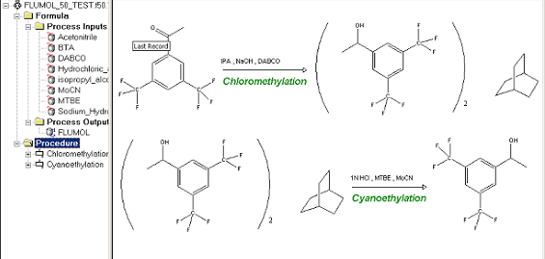
PPC – A Minimal Representation
Process Procedure Charts are a minimal representation
Other views of the process definition may be needed by other users
For example, a chemical view may be better for R&D chemists

Slide 65
Summary
ISA 88 Part 3 defines a minimal standard representation
Actually contains two types of diagrams
  Material flows (showing stages and operations)
  Sequence diagrams (showing operations and actions)
A table format is also defined, usable for simple sequences and limited parallelism

Slide 66
Agenda
Introduction
ISA88 Product Hierarchy Model
ISA88 Equipment Independent Recipe Model
ISA88 PPC representation
ISA95 Operations Model
Practice

Slide 67
ISA-95 Operations Definition Model
The ISA-95 Operation definition model describe the purpose oriented activities of the industrial facilities
  The “knowledge” about making the product, processing inventory operations, testing/qualifying resources and product, maintaining the facility equipment...
  However, it does not expose the knowledge itself, but identifies its breakdown and resource commitment
This model describes the product as a kind of achievement (here, the product) in terms of hierarchical stages, the “Operations segments”
It shares the common segment pattern
  See Physical Process Management

Slide 68
ISA-95 Operations Definition Model for Product
ISA95 focuses on supervising manufacturing,
  It does not care much about processing details
  It essentially manages resources
The Operations Definition model implements a resource view of Product Asset
  Can implement the product hierachy and EIR models
  Based on the common Segment pattern
It defines
  Resource (Equipment, Personnel, Material) specification
  Specific parameters
  Links to external business information

Slide 69
Operations Definition Model Elements (for Product)
Operations Definition (product)
  “collection of information about materials, production rules and scheduling required to create a product”
Operations Segment (product)
  “logical grouping of resources (personnel, equipment, and material) specifications required of a process segment to complete a production step for a specific product
Operations Material Bill (product)
  “the subset of the bill of material that is related to production”
Parameter
  “Information that is required by the operation system for correct manufacturing”
Resource (Personnel, Equipment, Physical Asset, Material) specification
  “An identification, reference, or correspondence to a resource capability”

Slide 70
Operations Definition Model

Slide 71
Operations Definition Model Elements (for Product)
Bill of materials
  “listing of all the subassemblies, parts, and/or materials that are used in the production of a product including the quantity of each material required to make a product”
  MRP II planning information
Bill of resources
  “listing of all resources and when in the production process they are needed to produce a product”
  Production scheduling / Advanced planning and optimization information
Work Definition
  information used to instruct manufacturing operation how to produce a product - Refers to detailed Control system information, Manufacturing instructions (Recipes, Setup / assembly instructions…)

Slide 72
Implementing the ISA Product Hierarchy model in ISA95
ISA 95
Operations Definition
ISA 88
Product Hierarchy
Operations
Definition
Process
Procedure
Equipment specifications
Material Specifications
Parameters
Operations
Segment
Process
Stage
Equipment Constraints
Material In/Out
Parameters
Equipment specification
Material Specification
Parameters
Operations
Segment
Process
Operation
Equipment Constraints
Material In/Out
Parameters
Equipment specification
Material Specification
Parameters
Operations
Segment
Process
Action
Equipment Constraints
Material In/Out
Parameters

Slide 73
Agenda
Introduction
ISA88 Product Hierarchy Model
ISA88 Equipment Independent Recipe Model
ISA88 PPC representation
ISA95 Operations Model
Practice

Slide 74
Practice
(1) Product Hierarchy
  Give possible names and examples for the product hierarchy level
(2) Product Parameter
(3) Process Element Classes
  For some process actions, define
    Parameters (settings)
    Data (Relevant information to collect)
    Environment requirements
    Pre-conditions
    Post-conditions
    Exception and handling
(4) Process Definition
  Define a Product procedure using the 4 standard levels
    Up to the detail of an operation using some of the above Process Actions
    Identify IN/OUT material from Exercises (1)

Slide 75
Thank You !

