Slide 1
Sequencia
Partner Tools
20 Minute OpenBatch
Review

Slide 2
20 Minute Review
Suggested use
  This is intended to show some of the basic functionality of OpenBatch and explain some of the concepts of batch automation
    It lists the high points of the product
    It shows some of the typical product screens
  The first time through run through this slowly,
  Run through this quickly for a review

Slide 3
Batch Automation Elements
There are three basic elements involved in batch automation
  1: Defining the basic processing capability of the equipment
  2: Defining recipes for products
  3: Making batches
This is all based on the international standard for batch control systems
ISA S88.01 (also known as IEC 61512-01)

Slide 4



Batch Automation
Click here
anytime to return
to this screen
Click here to
go immediately to
Defining
Equipment
Capability
Click here to
go immediately to
Batch
Execution
Click here to
go immediately to
Recipe
Definition

Slide 5

Equipment Capability Definitions
The basic capability of the equipment must be defined
  Capability that is usually product independent
  Such as; heating, cooling, charging, mixing, transferring, …
  Associated to specific equipment
Capability may be performed automatically or manually
Defined using the Equipment Editor
Equipment
Definition

Slide 6
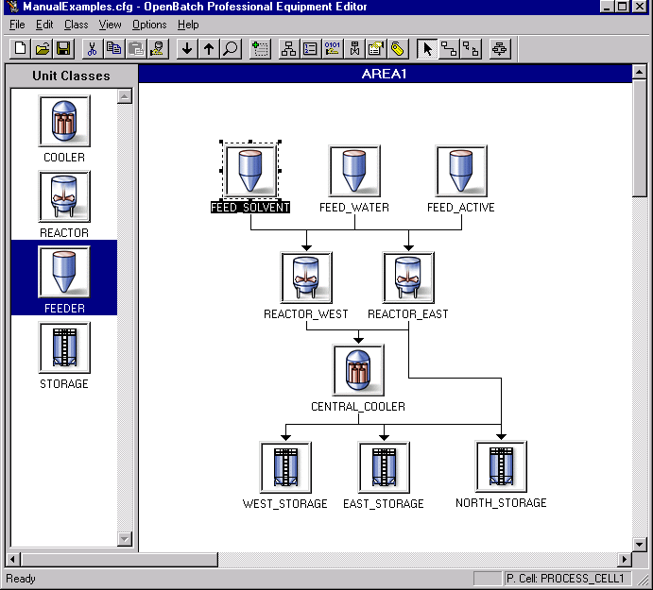
Equipment Editor
Define the equipment model using a simple graphical configuration
The equipment editor is run, off-line, to define what the equipment is capable of doing
You also use the equipment editor to define the mapping (addresses or names) to the PLC and DCS systems that implement the functions
This defines the configuration that only changes when new processing capability is added, such as new vessels and new piping, or when new control capability is added.

Slide 7
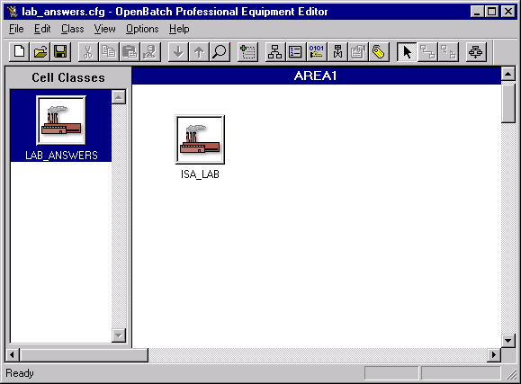
Top Level - Process Cells
Define a process cell class for each type of process cell being controlled
Batches run to completion in a process cell
This follows the S88.01 equipment hierarchy model
  Process cells
  Made up of units
  Units contain equipment phases
Each OpenBatch server can support multiple process cells
A process cell is (in S88 terms) all of the equipment required to make a batch.
Process cell classes are ways to visually identify different types of cells.

Slide 8
Drag and Drop Configuration
Drag and drop a cell class into the workspace to define a cell
Starting an equipment model is a simple process of creating a process cell class and then creating a specific cell
Icons represent the process cells, units, and equipment phases
A process cell can contain multiple batches at the same time.

Slide 9
Define Units and Flow Paths
This defines a class of units
This defines a specific unit
Create units the same way
A unit operates on only one batch at time
A unit performs major processing actions on a batch
Define connections between units to show flow paths of materials
This shows connections between units

Slide 10
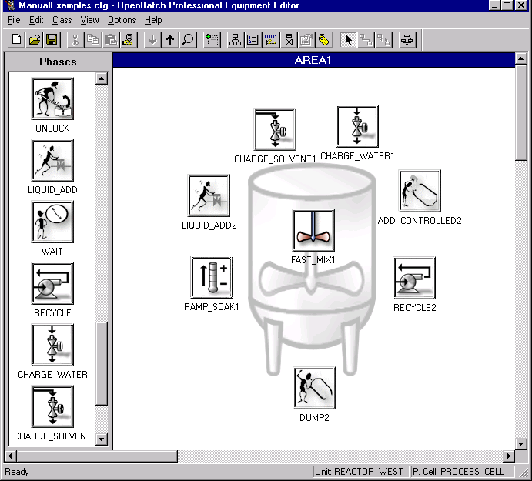

Equipment Phase -
Basic Equipment Capability
Equipment phases define what the basic processing equipment is capable of doing
  Such as heating, mixing, adding ingredients, transferring materials, …
Each phase is a minor processing action on the batch
It does not matter if the function is performed manually or automatically
Define a phase and drop it onto the unit definition. This defines an equipment capability available in the unit.

Slide 11
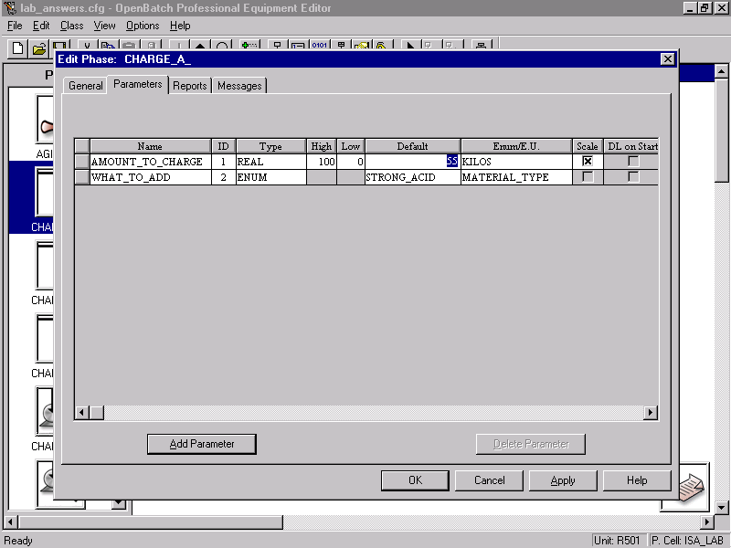

Phase Parameters
Phases may have parameters
Parameters define information to be sent to the phase before it executes
Examples are
  temperature setpoints
  materials to be added
  amount to be added
  mixing times
  heating times
  ...
The parameter may be used by the controller logic, or referenced in manual instructions
Define the parameters sent to the phase from the recipe

Slide 12


Report Parameters
The reports are sent back by the controller logic, or entered by operators for manual phases
Phases may report back values during or after their execution
Such as
  Actual amount added
  Actual temperature
  Actual pressure
Report parameters may be manually entered by the operator or automatically collected by control equipment
Define the parameters reported back to the recipe from the phase

Slide 13
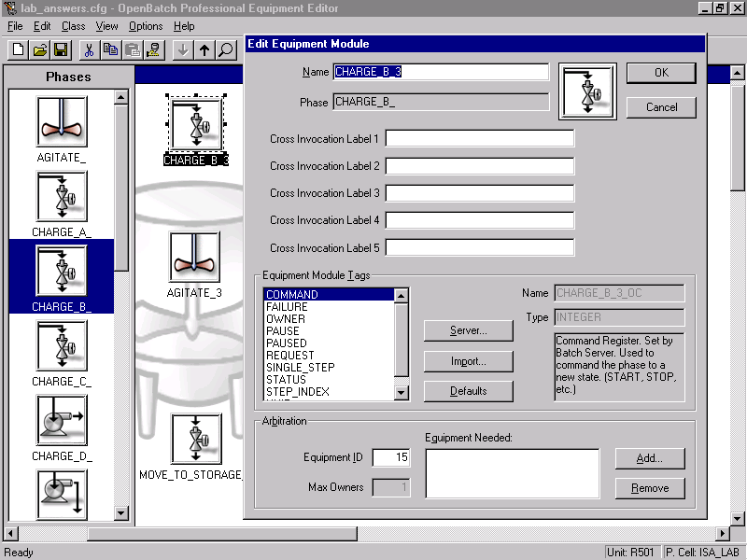

Equipment Interface
The equipment editor is where you specify the interface to the control equipment for the phase
The interface can be DDE or OPC to PLC or DCS systems
The interface may be an annotated SOP document for manual operations using Procedure Manager
These are tags in the DCS, or registers in the PLC that the controller logic uses to communicate to OpenBatch
This defines the interface to controller logic.

Slide 14


Manual or Automated Functions
Equipment phases may be executed in control equipment, such as DCS or PLC systems
Equipment phases may be executed manually, where instructions are presented to operators using Sequencia's Procedure Manager
Identify document
that specifies how
to accomplish
the function
Identifies the data exchanged with a section of code in the controller that implements
the function
Manual
Phase
Automated
Phase
Step 1: Check vessel
Step 2: Open the drain valve
...

Slide 15

A Full Equipment Model
Process
Cell
Summary
  OpenBatch's Equipment Editor is used to define the process cells, units, and equipment phases available for batch manufacturing
  The equipment model is used when creating recipes and when creating batches
  Click again to see a complete process cell definition
UNIT
Precharge D
UNIT
Premix B
UNIT
Storage A
UNIT
Precharge B
UNIT
Premix A
UNIT
Reactor
UNIT
Storage B

Slide 16
Recipes
Recipes define how to make products
Recipes are created using the Recipe Editor
Recipes are executed in the OpenBatch run time system
Recipes follow the S88.01 standard
Recipe
Definition

Slide 17

Recipes and Equipment
Recipes use the equipment information defined in the Equipment Editor
Recipes define the ordering and sequencing of the equipment phases
The recipes specify when the
phases are to run, but the
equipment phases do all of
the real work
I define
how
I say
when
Equipment
Recipe

Slide 18

Recipe Format
Recipes are created, and displayed in a graphical format called SFCs - Sequential Function Charts
This format allows the easy
display of sequential steps,
alternate steps, and
parallel steps

Slide 19
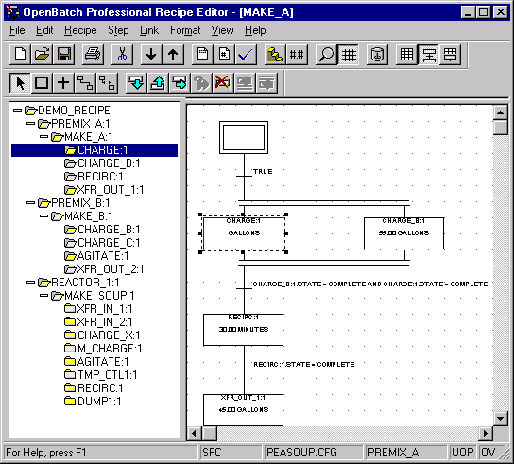

Recipe Editor
The recipe editor is used to create and modify recipes
Usually there is one recipe per product
The main part of a recipe is the "PROCEDURE"
  The ordering of actions required to make the product
The procedure is structured according to the S88.01 model
Recipes are made up of Unit Procedures, Operations, and phases
The same Unit Procedures and Operations can be used in multiple recipes to speed recipe development

Slide 20

Rapid Editing
The recipe editor has features to make recipe creation and editing easy and error free.
Recipes can be modified at any time and made immediately available for execution.
Editing shortcuts make it easy to create and edit recipes
The shortcuts make sure the recipes are correctly defined.

Slide 21

Recipe Editing
Recipes use the phases defined in the equipment model
The lowest level of the procedure is a "Recipe Phase"
A recipe phase references an equipment phase
  For a specific piece of equipment
  Or for a class of equipment
I can only use the phases defined in the equipment editor, but I select the order of execution !

Slide 22
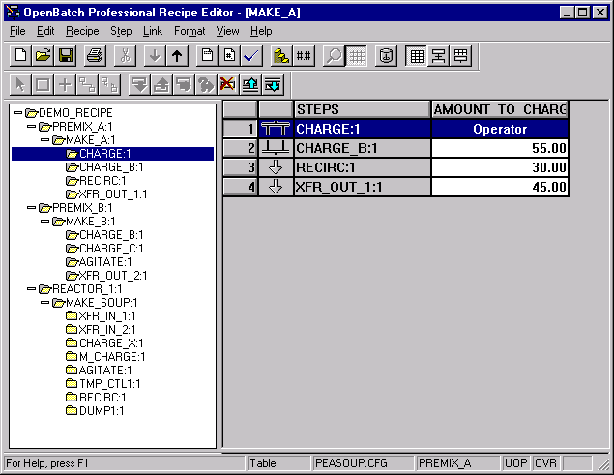

Recipes in a Simple Table Format
Recipes can be displayed and edited in the graphical view or in the table view.
Simple recipes require simple display
So simple recipes can be displayed in a table format for occasional users
The table view is more compact and easier to understand for simple recipes

Slide 23
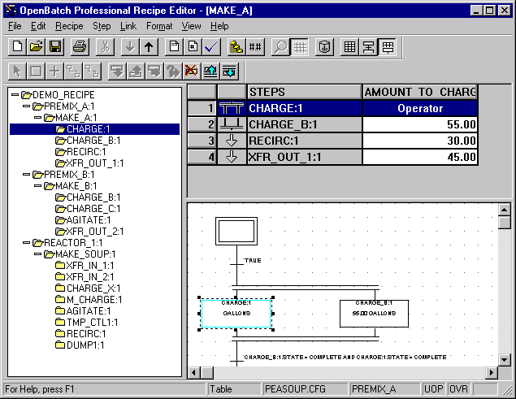

Multiple Views
You can even show the table view and the graphical SFC view at the same time
Using the recipe editor, recipes can be created in very short times
Using the alternate views, recipes can be read and reviewed by people not familiar with OpenBatch
It is even possible to see the table and graphical view at the same time.
These are easy to understand, but they are also very powerful tools !

Slide 24
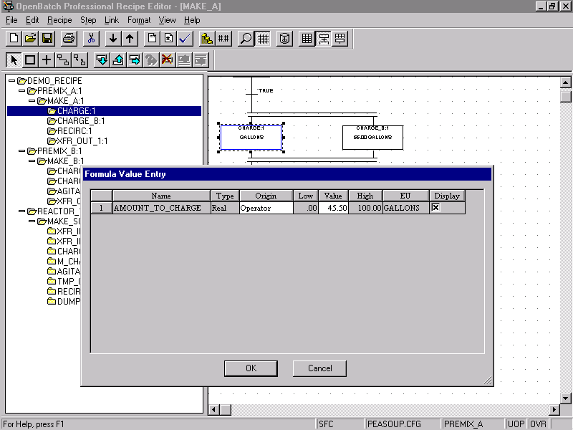

Phase Parameters
Define the parameter values that will be sent to the equipment phase when this recipe runs.
When you create a recipe you can specify the specific parameters to be sent to a phase before it executes
Such as a temperature setpoint, or the amount of material to add
This is how I use a phase to perform different tasks based on the recipe I am defining !

Slide 25

Recipe Summary
With the right authority, recipes can be created and modified at any time.
Recipes are the key element of batch automation
They define how to make a specific product, without specifying how the underlying functions are preformed
OpenBatch includes other information as well
  Formula values
  Author identification
  Comments
  Equipment requirements
The next time the recipe is used, the new definition is picked up

Slide 26
Batch Execution
OpenBatch is not just a recipe editor, it also executes the recipes
There is a run-time component of OpenBatch that runs recipes under operator control
Batch
Execution

Slide 27


Recipes and Operations
Operations is where it all comes together
Operators execute batches and select equipment they will run against
I will use your recipe definitions
I will use your equipment definitions

Slide 28
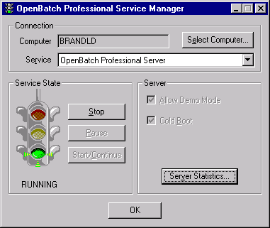

Batch Execution
Usually the OpenBatch server is configured to auto start, so I don't have to worry about this software stuff
Batches are executed in the OpenBatch run time system
OpenBatch runs as a Windows-NT service
  OpenBatch can auto start, so no operator intervention is required
An OpenBatch server can communicate to multiple PLC and DCS systems to control multiple process cells
OpenBatch uses DDE and OPC to communicate to control equipment
This is sometimes used to aid in startup and commissioning !

Slide 29
Operation - Batch List
The Batch List is usually shown as an Active-X control in an HMI, or in a WEB Browser
This shows all of the batches currently scheduled, running, and completed in the process cell.
This shows what equipment the batch is running in.
This shows the state of the batch; idle, running, complete, held, aborted.
This shows when the batch started.
This shows the batches currently in the batch list.
This shows how long the batch has been running.
This shows the recipe the batch is running.

Slide 30
Operation - Controlling Batches
A simple right click brings up the menu to add and control batches
Batches can run in manual, semi-automatic, or automatic mode
Operators can start, hold, restart, stop, or abort batches
  If they have the correct privileges
I use the "Create Control Recipe" command to add new batches to the batch list
I use the "Comment" command to add a comment to the batch journal
I use the "Remove" command to remove completed batches from the batch list
I usually only use these when something goes wrong

Slide 31


Operations - Recipe Procedure
This shows the active steps and the transitions being evaluated
I can also use this display to control the recipe procedure
I usually only control the order of execution when something goes wrong
Another Active-X control is the procedure view
This can also be included in any HMI display to display and control a specific batch's recipe

Slide 32

Recipe Procedure - Control
Performing these actions require I have the right security privileges
Right click to bring up the menu to control the recipe procedure
These can also be easily configured as buttons
The newest version of OpenBatch further integrates these controls into your HMI
or DCS displays
Security Control is integrated with standard Windows-NT security

Slide 33

Operations - Prompts
When Procedure Manager is not installed, then the "Prompt List" Active-X control provides access to "prompts"
Prompts are requests for values from the operator
  These are report parameters that the operator must supply for the batch to continue
I need to enter a value for the batch to continue
Prompts are defined in the recipe editor

Slide 34
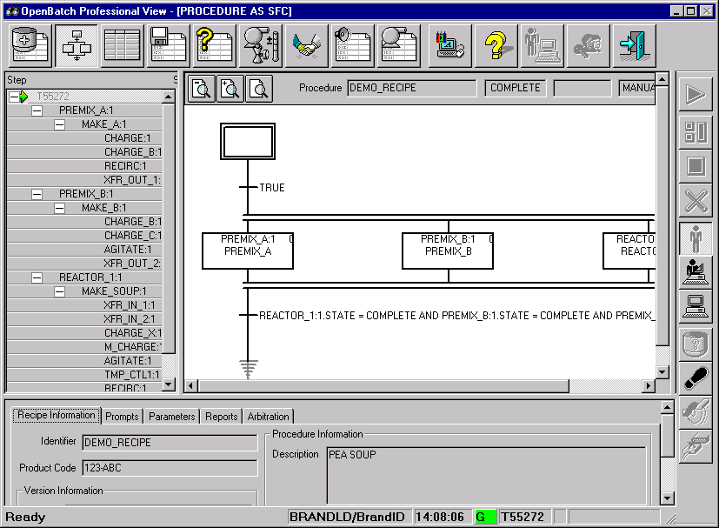
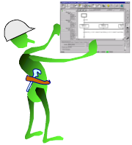
Classical Operations View
OpenBatch also has a stand alone operations interface
All of the previous functions, as well as additional functions for debugging, are provided by this Windows-NT application
I can do all batch actions from this application
Usually I will control the batches using the Active-X controls and my HMI or browser

Slide 35

Batch Journals and Reports
OpenBatch also collects all of the information about the execution of a batch into a batch log
Reports can be built against the batch
log, or the information can go
into a database for analysis
This information is very valuable, and it is automatically recorded.
The electronic batch log means I need to do less paperwork !

Slide 36
OpenBatch Programs
The Archiver saves the batch log into a database
This lets me control the batch server
The following programs are provided with OpenBatch
Not all programs need to be installed on all computers
OpenBatch runs as a full client server architecture
  Editing may be done from any computer on the network
  Viewing may be done from any computer network
This starts the equipment editor
This starts the recipe editor
This starts the report editor
This lets me simulate the control hardware for testing
This starts the standalone OpenBatch viewer

Slide 37
Operations Summary
OpenBatch is recipe execution, batch logging, batch reporting, and recipe editing
Sequencia provides complete solutions for batch automation
  OpenBatch
    Recipe execution
  Production Manager
    Manual and semi-automated operations
  Procedure Manager
    Integration with ERP systems
OpenBatch is the open solution. They work with all major control vendors.
OpenBatch works with Honeywell, Rockwell, GE, Aspen Technologies, Siemens, Ci Technologies, and many others.

Slide 38
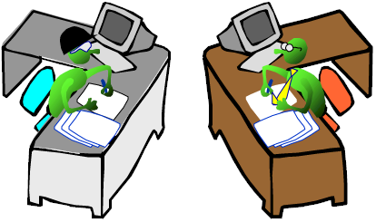
Services and Training
Least we forget, Sequencia also offers services
  Help in defining the equipment layout and organization
  Help in defining the phases
  Help in initial recipe building
And Training
  On site
  Any Sequencia office
Sequencia has a large staff of batch experts to help.
Sequencia wants to make every batch project a successful project !

Slide 39

For more information visit our web site at
www.sequencia.com
or contact our sales coordinator at
sales@sequencia.com or call 602-896-3800

