Slide 1
Work: | ISA8895 Implementation
Section: | Function
Chapter: | Operations Management
Language: | English
Version: | V3 - 05/2011

Slide 2
Agenda
Introduction
ISA95 Operations Activity Model (Production example)
Operation Processes / Task definition

Slide 3
CC functional domains
ISA-95
Product Asset Management
Inventory Asset Management
Physical Asset Management
Human Asset Management
IT Asset Management
ISA-88
TOGAF
ITIL
ISA-88 + ISA-95

Slide 4
Information Elements
Domain | Model | Std | Information elements
Product Asset | Product Product | ISA88 ISA95 | Product Hierarchy Product Definition
Inventory Asset | Material | ISA95 | Material Resources
Physical Asset | Physical Equipment | ISA88 ISA95 | Equipment Hierarchy Equipment Resources
Human Asset | Personnel | - ISA95 | Personnel Hierarchy Personnel Resources
Equipment Control | Procedural | ISA88 | Functional Hierarchy Equipment Procedural Elements
Physical Process Control | Procedural | ISA88 | Physical Processes / Procedural Elements Physical Process Transform Components
Physical Process Mngt | Segment | ISA95 | Segments
Operation Process Mngt | Operation Activity | ISA95 | Operation Processes Activities / Tasks

Slide 5
Who’s / What’s concerned?
PRM | Usr/Rsp | Usage | Typ.IT app
Customer order processing | X
Production planning & scheduling | X
Production control | R
Material and energy control | X
Procurement
Quality assurance | X
Product inventory control | X
Product cost accounting | X
Product shipping administration
Maintenance management | X
Research & development
Engineering
Marketing and sales
Finances | X
Human Resources | X
Information technologies

Slide 6
Operations Process Management Domain
OPM typically corresponds to most of the ISA95 part 3 activity model
However, ISA95 is unclear around the “Execution Management” bubble
  This mirror the current confusion about what is done in control systems and MES
  Sometime “Automated” actions are handled by control system, while manual actions are handled by MES…
Basically, OPM deals with Management, not Control:
  It must not be constrained by Real Time focus
    Asynchronous Execution - If a task’s completion is requested to move forward the physical process with impact on work throughput, it must be handled by the Physical Process Control level (Recipes / Operating procedures…)
  It is typically not product dependent
    Asynchronous Definition - A new product generally not lead to define new Operation processes

Slide 7
OPM domain
For example:
  Dispatching instruction for working on a particular work station is part of an OP
    It is clearly defined in ISA95 part 3 activity model
    It is done early enough to allow a delay in task’s completion
  Identifying a material to be added,
    Forbidding the use of the material or making the production not acceptable if not completed upfront will make the function part of Physical Process Control, not a BP task
    Being required only for information / reporting purpose make this function possibly handled as a BP Task.
Basically, no conceptual difference between
  OP/Task (Management)
  RPE/EPE (Control)
  Company specific policies must be set

Slide 8
Generic Activity model
1.Detailed
scheduling
8. Resource
management
5.Tracking
2.Dispatching
6.Analysis
7.Definition
management
4.Data
collection
3.Execution
Management
Source: ANSI/ISA 95
Enterprise/Control System Integration

Slide 9
Different MES Focus
Decisional focus
  Business / Execution
  Decisional / Physical Hierarchy : Work station, Work cell, Area, Site, Enterprise…
Operational Responsibility focus
  Manufacturing, Inventory, Quality, Maintenance…
Timing focus
  Before, during, after work execution
Maturity focus
  Visibility, Control, Optimization

Slide 10
(1) Decisional focus : MES Domains and Functions
Order
Processing
(1.0)
Business
Responsibility
Domain
Product Cost
Accounting
(8.0)
Product
Shipping Admin
(9.0)
Production
Scheduling
(2.0)
Execution Responsibillity Domain
Material and
Energy Control
(4.0)
Production
Control
(3.0)
Product
Inventory Control
(7.0)
Procurement
(5.0)
Quality
Assurance
(6.0)
Marketing
& Sales
Maintenance
Management
(10.0)
Research
Development
and Engineering
Source: ANSI/ISA 95
Enterprise/Control System Integration

Slide 11
(1) Decisional focus : Hierarchy according to ISA95
ENTERPRISE
SITE
AREA
Work Center
Work Unit

Slide 12
(2) Operational responsibility focus : Domains according to ISA95
Order
Processing
(1.0)
Product Cost
Accounting
(8.0)
Product
Shipping Admin
(9.0)
Production
Scheduling
(2.0)
PRODUCTION
OPERATIONS
MANAGEMENT
Material and
Energy Control
(4.0)
Production
Control
(3.0)
INVENTORY
OPERATIONS
MANAGEMENT
Product
Inventory Control
(7.0)
INVENTORY
OPERATIONS
MANAGEMENT
QUALITY
OPERATIONS
MANAGEMENT
Procurement
(5.0)
MAINTENANCE
OPERATIONS
MANAGEMENT
Quality
Assurance
(6.0)
Marketing
& Sales
Maintenance
Management
(10.0)
Research
Development
and Engineering
Source: ANSI/ISA 95
Enterprise/Control System Integration

Slide 13
(2) Operational responsibility focus : Beyond Production
Manufacturing Operation Categories (MOCs) in ISA95:
  Production
  Quality tests
  Maintenance
  Inventory control
Other possible MOCs :
  Distribution, Transportation
  Inbound, Outbound logistics
  Internal transfers
  Tooling
  Cleaning
  …
1.Detailed
scheduling
8. Resource
management
5. Tracking
2. Dispatching
6. Analysis
7. Definition
management
4. Data
collection
3. Execution
Management

Slide 14
(3) Timing focus
Before operation execution
  These activities are performed before Production occurs
During operation execution
  These activities are performed while production continues
    Real time interaction
After operation execution
  These activities are performed
    After Production has been completed
    While Production is performed, but not synchronously
Not time related
  These activities are performed independently of production
    Provide necessary information for production
    May be affected by production (resource status and usage)

Slide 15
(3) Timing focus MES Main Functional areas
Pre-Work
Detailed
Scheduling
Post-Work
Reference data
Tracking
Resource
Management
Dispatching
Analysis
Definition
Management
Actual Work
Data
collection
Execution
Management

Slide 16
(3) Timing focus : Main activity flows
Detailed
Scheduling
Tracking
Resource
Management
Analysis
Dispatching
Data
Collection
Definition
Management
Execution
Management

Slide 17
(4) Maturity level
Visibility:
  Data collection, performance monitoring, reporting
Control:
  Work Specification enforcement,
  Quality control,
  Operation conformance against defined practicies
Optimization, anticipation:
  Statistic or Real time process improvement
  Resource usage optimization
  Performance objectives and improvement processes against strategic criteria

Slide 18
Agenda
Introduction
ISA95 Operation Activity Model (Production example)
Operation Processes / Task definition

Slide 19
Applying the Generic Activity model to Production MOC
Can be applied to:
Inventory
Quality Control
Maintenance
+…
Detailed
production
scheduling
Production
resource
management
Production
tracking
Production
dispatching
Production
Analysis
Product
definition
management
Production
data
collection
Production
Execution
Management

Slide 20
1. Detailed Production Scheduling
(Before)
Detailed
production
scheduling
Production
resource
management
Production
tracking
Production
dispatching
Analysis
Product
definition
management
Production
data
collection
Production
execution
Production Plan Generation
  At a level of detail below corporate planning
Finite capacity scheduling
  Recognize alternative and parallel operations & exact timing
Production
Schedule
Production
Schedule
Production
Schedule
Resource
Information
Detailed
Production
Scheduling
Detailed
Production
Scheduling
Resource
Information
Detailed
Production
Schedule
Detailed
Production
Schedule
Detailed
Production
Schedule
Detailed
Production
Schedule

Slide 21


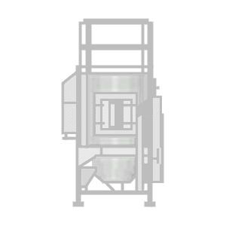


2. Production Dispatching
(Before)
Detailed
production
scheduling
Production
resource
management
Production
tracking
Production
dispatching
Analysis
Product
definition
management
Production
data
collection
Production
execution
Managing flow of production by dispatching work
  Work orders/Batches to work units
  Material movement request
Download automatically in response to the schedule or on request
  Recipes/Routings to equipment
  Work instruction, SOP, drawings or electronic data to work stations
Detailed
Production
Schedule
Production
Dispatching
Setup
Machine
Produce
Batch
Move
Ticket
Continuous
Premix
Batch Production
Process
Material
Movement

Slide 22
3. Production Execution
(During)
Detailed
production
scheduling
Production
resource
management
Production
tracking
Production
dispatching
Analysis
Product
definition
management
Production
data
collection
Production
execution
May be manual or automated
Includes
  operators actions based on instructions dispatched to operators
  automated actions through control systems

Slide 23
4. Production Data Collection
(During)
Detailed
production
scheduling
Production
resource
management
Production
tracking
Production
dispatching
Analysis
Product
definition
management
Production
data
collection
Production
execution
Collecting operational data
  Production and parametric
  Associated with production equipment and production processes
Concerns
  sensor readings, equipment states, event data, operator entered data, operator actions, and everything of importance in the making of a product or analysis of products, processes, or production
Includes
  Real time data collection
  History of production data
    Addressed in ISA88 part 4

Slide 24
5. Production Tracking
(After)
Detailed
production
scheduling
Production
resource
management
Production
tracking
Production
dispatching
Analysis
Product
definition
management
Production
data
collection
Production
execution
Track actual production and performance to the production plan
Information transferred back to scheduling so that plans & schedules can be updated
Monitor and track the status of production
Data reconciliation
  Consolidate production information
Genealogy/Product Traceability
  Collects, prepares and provides material transformation and relationship information to inventory management systems

Slide 25
6. Production Analysis
(After)
Detailed
production
scheduling
Production
resource
management
Production
tracking
Production
dispatching
Analysis
Product
definition
management
Production
data
collection
Production
execution
Product analysis
  product quality control, SPC / SQC tracking
  In-Line control by operations staff
  off-line inspection & analysis in Laboratory Information Management Systems (LIMS)
    Addressed by Quality Operation MOC
Process analysis
  Analyses and optimizes physical process performance regarding Product quality and variability
Production analysis
  Analyses and optimizes production performance regarding Cycle times, Resource utilization, Procedure efficiencies, and Production variability

Slide 26
7. Product Definition Management
(Reference data)
Detailed
production
scheduling
Production
resource
management
Production
tracking
Production
dispatching
Analysis
Product
definition
management
Production
data
collection
Production
execution
Manage recipes, work instructions, Product production rules, Product segment
  Synchronize this information with other systems
General/Master Recipes, Product / process segments mapping
  (alt. Resource management)

Slide 27
8. Resource Management
(Reference data)
Detailed
production
scheduling
Production
resource
management
Production
tracking
Production
dispatching
Analysis
Product
definition
management
Production
data
collection
Production
execution
Personnel management
  Maintain personnel Attendance, availability, status, location, exposure qualification information …
Material management
  Inventory operations, relationship with MM systems
  Mostly addressed by Inventory Operation MOC
Equipment management
  Maintain equipment status,location, availability
  Relationships with LIMS, Asset Management, Maintenance Management, Production Planning, Mostly addressed by Maintenance Operation MOC
Process Segment management
Product / Process segment, General/Master recipes mapping
  (alt. Product definition)
Production capability

Slide 28
Applying the Activity model to other MOCs
Inventory
Quality Control
Maintenance
+…

Slide 29
Supporting functions
These functions provide
  Suitable technical framework
  Global services and procedures
  Not directly linked to Production’s main purpose

Slide 30
Supporting Functions: McDo model
Detailed
work
scheduling
Management
of regulatory
compliance
layer
Work
resource
management
Work
tracking
Work
dispatching
Work
Performance
analysis
Work
definition
management
Work
data
collection
Operational
activity level
Management of
security layer
Work
Execution
Management
Management of
documents layer
Management of
Configuration layer
Management of
Incidents &
deviations layer
Management of
information layer

Slide 31
A Tri-dimension functional framework
Manufacturing Operation Categories
Production
Maintenance
Quality
Inventory
…
Operation
Processes
Manufacturing Operation Core Functions
- Detailed Scheduling
- Dispatching
- Execution Management
- Data Collection
- Tracking
- Analysis
- Definition Management
- Resources Management
Functional Requirements (Tasks)
Execution/Manufacturing
Business/Planning
Supporting activities
- Management of security
- Management of information
- Management of configurations
- Management of documents
- Management of regulatory compliance
- Management of incidents and deviations

Slide 32
Agenda
Introduction
ISA95 Operation Activity Model (Production example)
Operation Processes / Task definition

Slide 33
Terminology
Operation Process, Activity, Task
  ISA95 uses the term of “Activity” for the main breakdown of its “activity model”.
  It further details these activities into “Tasks”, which are the appropriate level for functional requirements.
  ISA95 Activity is a task classifier
  ISA95 ignores Operation Processes.
  BPM standard terminology uses Activity in the sense of ISA95 Tasks
CCM uses the terms
  Operation Processes
  Activity as a Task classifier (consistent with ISA95)
  Tasks (in the ISA95 sense),

Slide 34
Iterative OP/Task Definition
OP Identification
Operation Processes
OP Design/Task Id
Task Description
Tasks
Task Classification

Slide 35
Operations Processes
BP Identification
BP Design/Task Id
Task Description
The highest level in the Control Chain
They define
  Operation contexts
  Task (functional services) activation scenarii / orchestration applicable in these situations
They can be:
  Manual
  Automated
  Assisted
They can be hierarchical:
  High level processes trigger lower level processes
  Elementary processes are Tasks
Task Classification

Slide 36
Operations Process Classification
BP Identification
BP Design/Task Id
Task Description
1. Execution Management
  Concerns directly the organization, the launch and the follow-up of work execution
  Specific to MOC or shared by several MOCs
    Example : Scheduling of production
2. Resources Management
  Concerns activities related to resources, but not directly to work orders
    Example : Monitoring employee qualifications, follow up of equipment performance, of material obsolescence …; Genealogy, equipment and personnel performance
3. Global Operations Management
  Dashboards, performance indicators not directly related to work orders
  Activity reports per shift/day/week/year
Task Classification

Slide 37
Operations Process Classification
BP Identification
BP Design/Task Id
Task Description
4. Definition/Synchronisation of Master Data
  Concerns maintenance of technical data (Products, resources)
    Example: Conception of a new product, involving synchronized processing at management and execution systems level
The classification strongly depends on management options
  The conception of a product could be integrated in the execution management (dynamically) or in synchronization of master data (statically) depending on the instances
Task Classification

Slide 38
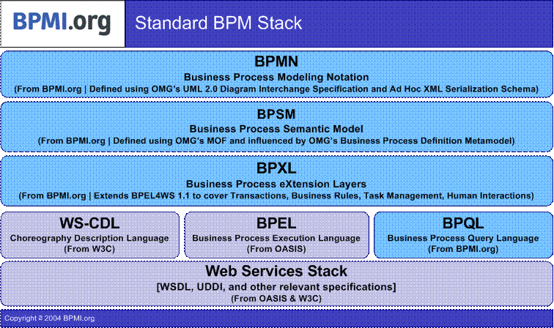
Operations Process Design: BPMN Language
BP Identification
BP Design/Task Id
Task Description
Developed by BPMI www.bpmi.org www.waria.com )
  Business Process Management Initiative / Workflow and Reengineering International Association
  Member du Workflow Coalition W3C, OASIS, OAG, WFMC
Task Classification

Slide 39
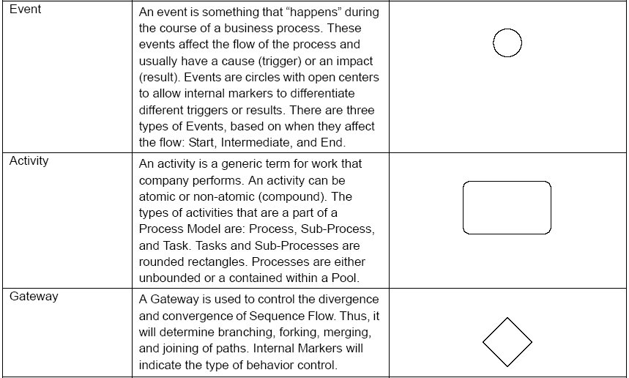
Business Process Design : BPMN Language
BP Identification
BP Design/Task Id
Task Description
Task Classification

Slide 40
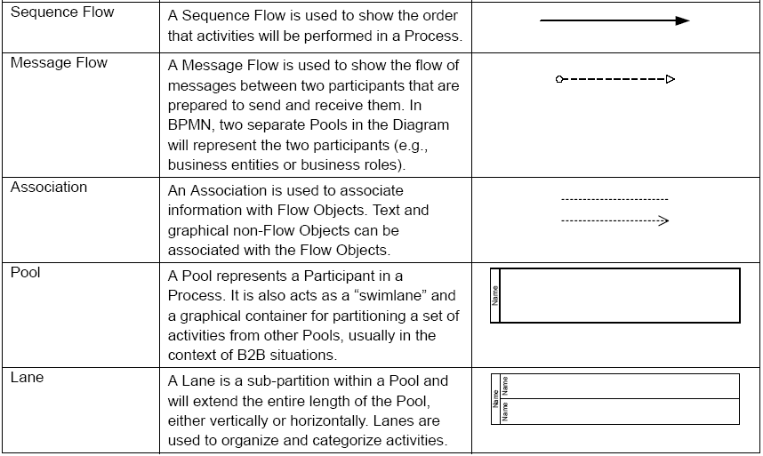
Business Process Design : BPMN Language
BP Identification
BP Design/Task Id
Task Description
Task Classification

Slide 41
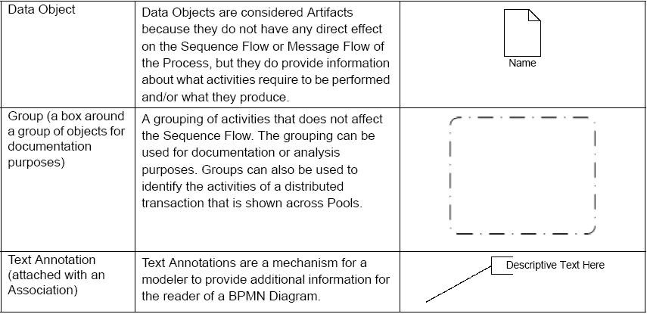
Business Process Design : BPMN Language
BP Identification
BP Design/Task Id
Task Description
Task Classification

Slide 42
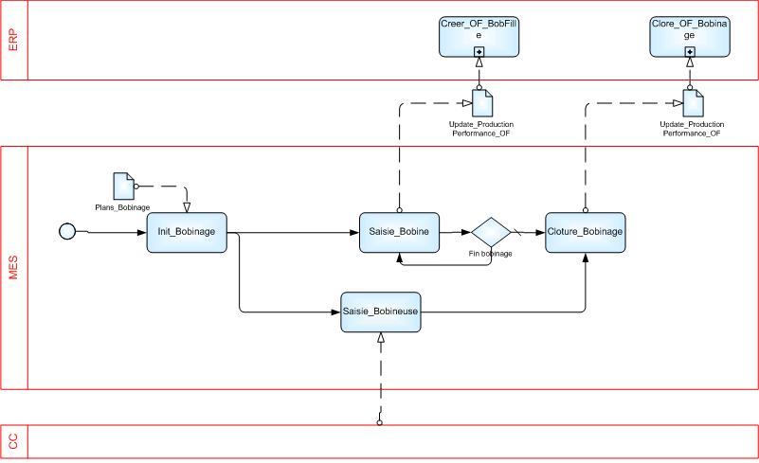
Example

Slide 43
Task Identification
BP Identification
BP Design/Task Id
Task Description
The definition of operation processes in the preceding steps allows to build the list of tasks handled by these processes.
The tasks are defined and organized within the activities of ISA95-3 models
The following steps will modify this list by rapprochement, consolidation, “objectification”
  The operation processes will be arranged to take into account the tasks actually defined
  These 2 steps are thus carried out in a simultaneous and iterative manner.
Task Classification

Slide 44
Tasks Description
BP Identification
BP Design/Task Id
Task Description
The description of tasks includes 3 types of information:
  The Characterization which defines the attributes of use and justification of the task
  The Informational / Interface Requirements which links tasks to handled information
  The Functional Requirements which defines the services expected from the task
  Only the first type is considered here.
  The Informational / Functional requirements are discussed in
  CCM4 Information Service Specification
Task Classification

Slide 45
(1) Tasks Characterization
BP Identification
BP Design/Task Id
Task Description
Task Classification
Characteristic | Description
Decisional applicability MOC Usage Level User Profile | Relative Manufacturing Operation Categories - Applicable Physical/decisional level (Area, Work Centre, Work Unit…) - Personnel Classes involved in the execution of the task (access to the system)
2. Restrictions | Applicable Segment, Personnel, Material, Equipment (resources)
3. Typology IT Service Levels Style of processing | - What are the technical constraints (>>) - The type of information processing the task fulfils (>>)
4. Dependency | Other necessary tasks in order to implement this one. The dependences can “technically” impose tasks considered not to be economically profitable

Slide 46
(1) Tasks Characterization – Example of IT Service Levels
BP Identification
BP Design/Task Id
Task Description
Task Classification
Criteria | Exemple of criteria value per type
IT Service Level | « Control » | « Operation » | « Business »
Data Synchronism | Synchronous | Synchronous and Asynchronous | Asynchronous
Data Acquisition Cycle time | Real Time | < 5 seconds | N/A
Calendar of opening | 6D/7 24H/24 | 6D/7 24H/24 | 5D/7 8H/24
System availability | Very high | High | Average
Data integrity | Average | Very high | Very high
Environment | Industrial | Semi-industrial | Office

Slide 47
(1) Tasks Characterization - Processing Style
BP Identification
BP Design/Task Id
Task Description
Task Classification
# | Type | Description
RT | Real Time | Interaction with the process or the operator which directly impacts the production (normally excluded from the field of BPM)
TS | Transactional | Involves data requiring a high level of precision and reliability
ST | Data Storage | Collection, selection, consolidation, validation of information for purposes of later use
KM | Knowledge Management | Shaping of the collected information to facilitate and improve the operations
AN | Analytical | Information Analysis to help in decision-making. Can be coupled with manufacturing process or quality assurance
MD | Modelling and simulation | Asynchronous preparation processes of a principal activity, such as scheduling
CL | Collaborative | Connects independent activities and responsibilities for obtaining a common objective (non-structured)
WF | Workflow | Connects activities in a preset and structured manner

Slide 48
(2) Information
BP Identification
BP Design/Task Id
Task Description
The informational dimension of ISA95-2 can be introduced under 3 angles:
  To associate each task to models and objects of data used (inputs) and affected (outputs)
    Allows logical regroupings of tasks
  Particular information which the user needs
    Data presented / entered
  Contents of the publishing relating to the task
    Reports, labels, delivery order…
This sets a basis for standardized Information Service framework
  Enforcing independence of solutions
  Enabling SOA architectures
The following slides list the ISA95 data objects
  They are modified / generalized to apply to all MOCs
  See ISA95 part 2 for details of object attributes
Task Classification

Slide 49
(2) Information
BP Identification
BP Design/Task Id
Task Description
Task Classification
MOC
MOC
Activity
Activity
T
T
T
T
T
T
T
T
Mod/Obj Data
Mod/Obj data
Mod/Obj data
Mod/Obj data
Mod/Obj data

Slide 50
(2) Information – Generalized ISA95 model objects
BP Identification
BP Design/Task Id
Task Description
Capability Model | Work capability
 | Personnel capability
 | Personnel capability property
 | Equipment capability
 | Equipment capability property
 | Material capability
 | Material capability property
 | Work segment capability
 | Segment personnel capability
 | Segment personnel capability property
 | Segment equipment capability
 | Segment equipment capability property
 | Segment material capability
 | Segment material capability property
Task Classification

Slide 51
(2) Information – Generalized ISA95 model objects
BP Identification
BP Design/Task Id
Task Description
Personnel Model | Person
 | Person property
 | Personnel class
 | Personnel class property
 | Qualification test specification
 | Qualification test result
Equipment Model | Equipment
 | Equipment property
 | Equipment class
 | Equipment class property
 | Equipment capability test specification
 | Equipment capability test result
Task Classification

Slide 52
(2) Information – Generalized ISA95 model objects
BP Identification
BP Design/Task Id
Task Description
Material Model | Material class
 | Material class property
 | Material definition
 | Material definition property
 | Material lot
 | Material lot property
 | Material sublot
 | QA test specification
 | QA test result
Segment model | segment
 | Personnel segment specification
 | Personnel segment specification property
 | Equipment segment specification
 | Equipment segment specification property
 | Material segment specification
 | Material segment specification property
 | Parameter
Task Classification

Slide 53
(2) Information – Generalized ISA95 model objects
BP Identification
BP Design/Task Id
Task Description
Schedule model | Schedule
 | Request
 | Segment requirement
 | Parameter
 | Personnel requirement
 | Personnel requirement property
 | Equipment requirement
 | Equipment requirement property
 | Material requirement
 | Material requirement property
Task Classification

Slide 54
(2) Information – Generalized ISA95 model objects
BP Identification
BP Design/Task Id
Task Description
Performance model | Performance
 | Response
 | Segment response
 | Data
 | Personnel actual
 | Personnel actual property
 | Equipment actual
 | Equipment actual property
 | Material actual
 | Material actual property
Task Classification

Slide 55
(3) Functional Requirements
BP Identification
BP Design/Task Id
Task Description
The behavioural description of the tasks is declined under following headings:
  Description of the normal behaviours
  Description of exceptions
  Description of behaviours on exceptions
The level of detail will evolve during the project,
  the initial indications can be limited to the constraints and provisions specific to the business and the company
  The implicit requirements will be completed during the course of realization
See example of description sheet
Task Classification

Slide 56
Classification of the tasks
BP Identification
BP Design/Task Id
Task Description
The task carries the detail of the functional requirements,
  the ISA-95-3 activities constitute an element of classification
    The standard provides rather complete indications on the scope of the tasks within an activity.
  The tasks are described without concern on their implementation on a target system.
The tasks defined during the preceding steps are the fruit of a reflexion by category of exploitation
  In reality, some tasks are in common, are shared or similar and must thus consequently be brought together to offer a consistent breakdown
We obtain a reduced and more consistent task list.
  The functional descriptions and elements of characterization are amended if necessary (Iteration)
  This step leads to a classification of these reusable business object tasks within the company
Task Classification

Slide 57
Multi-purpose tasks
BP Identification
BP Design/Task Id
Task Description
The same task is defined for independent operation contexts
  only one specification
  Deals only one MOC at a time: independent data bases and users
Examples:
  Tasks involved in Work Definition Management can be handled by the same application using different databases.
  Analogy: MS Office
Task Classification
The same task applies to several MOCs

Slide 58
Specific Tasks
BP Identification
BP Design/Task Id
Task Description
The task is specific to a MOC
  tasks fulfilling similar roles in other MOCs are different
Examples:
  Tasks involved in executing a production or a maintenance order require significantly different functional capabilities
  analogy: Ms Project, SAP APO
Task Classification
The task is specific
to the MOC

Slide 59
Common tasks
BP Identification
BP Design/Task Id
Task Description
The task handles problems for several MOCs globally.
Example:
  Tasks involved in Resource Management can be ensured in a centralized manner
  Analogy: human resources management
Task Classification
The task covers
several MOCs

Slide 60
Exercises: Model Operation Management – Excel spreadsheet
(1.1) Define / Discuss Operation Process Categories
(1.2) Define / Discuss Manufacturing Operation Management Categories
(1.3) Define / Discuss Operation Activities
(1.4) Define / Discuss IT Service Level
(1.5) Define / Discuss Operation Task Styles
(2.1) Define Operation Process Classes
(2.1) Define / Consolidate Task Classes
(3.1) Instantiate Operation Processes on an actual facility

