Slide 1
MI - Enterprise System
Meta model and taxonomy
04/2011

Slide 2
Introduction
Enterprise system macro meta model
Enterprise system taxonomy

Slide 3
System view
Traditional views of an enterprise
  Describe the actual shape of the enterprise
  Identify main processes
    Marketing, Sales, R&D
    Planning and Logistics, sourcing and delivery
    Production, Quality, maintenance, Engineering…
  Example: SCOR, VRM, PERA
System view
  Does not care about the actual shape and inner functioning
  Only considers a high level meta model to map the main external interactions
  Focuses on the what influences this shape

Slide 4
System approach: « understand » the whole
An enterprise is an extraordinary complex system
  No way to understand and figure out every aspect
  Many aspects can be handled and seen differently
  Beyond the specific product related knowledge, apparently trivial activities might be organized and taken differently
    Maketing, sales, production scheduling, facility maintenance, research… are critical activities that might have unic approach in a given enterprise
      Public methods and theories offer basis for their handling. Example: TOC, Lean and 6 Sigma in Production. However, implementation is always specific given the particular organization and context.
However, its I/O can be more easily captured and classifed
  The Cybernetics introduced the concept of « Black Bok »
    Giving up understanding the inner complexity of a system
    Analyszing its external behaviour

Slide 5
System approach: acting locally for global results
The system approach consist in
  Defining and measuring the right enterprise metrics based on its external interactions
  Finding internal weaknesses and fixing them to improve is external – gloobal – behaviour
The intial steps are
  Identifying the enterprise system I/Os
    To help developping appropriate metrics
    A high level meta model of the enterprise
  Defining a classification framework for systemic improvement
    To identify the key system components acting on its behaviour

Slide 6
Introduction
Enterprise system macro meta model
Enterprise system taxonomy

Slide 7
Enterprise is an Open, Complex System
Physical interactions:
  Earth, other Enterprises, internal Resources
Noospherical interactions:
  Goals of the World, Humanity, Humans, Owners, other enterprises
Social interactions:
  Nations, NGOs, Trade unions, Family
Complies with cybernetics’ laws...
  Statistical behaviour on input change
...Not always
  Unpredictable reactions to unexpected events
A thermodynamic entity
  Consumes energy, applies it on matter
  “Heat” (waste energy) when badly controlled (thermal entropy)

Slide 8
Industry eco-system (anthropo-centric!)
Agriculture
Food Industry
Food
Biological-natural
machinery
Work
Maintenance of
Social Organization
Uranium
Energy Industry
Oil, Gas, Nuclear,
Wind, Sun, hydraulic
Usable
energy
Mechanical-artificial
machinery
Inspired by
J. de Rosnay,
Le Macroscope

Slide 9
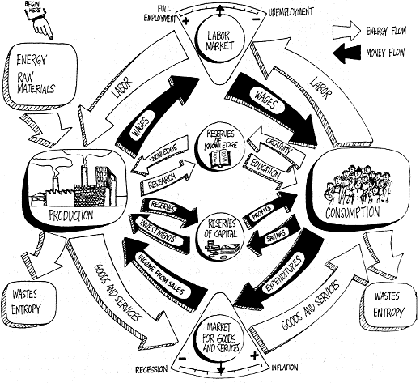
Industry Economics
Note : JDR represents only 2 flows: money and “energy” - Energy represents actually the 3 entities Energy / Matter / Information
From J. de Rosnay,
Le Macroscope

Slide 10
The enterprise black box: Energy Chain
Simplification for Industrial enterprises :
Energy / material grouped into Energy chain
Information not a managed outcome
Negentropy
Knowledge
Knowledge
Knowledge
Knowledge
Negentropy
Negentropy
Negentropy
Negentropy
E/M/I
Enterprise
E/M/I
Logistics
E/M/I
Enterprise
E/M/I
Biological
Consumption
Work
Entropy
Entropy
Losses
Entropy
Losses
Entropy
Losses
Losses
Earth
Entropy
Solar system / Milky Way Galawy / … /Universe

Slide 11
The enterprise black box
Government
Suppliers, Customers
Employees
Partners
Shareholders
Subcontractors
Environment
Bankers, Insurers
Information
Enterprise
Manufacturing
System
Information
Negentropy
Money
Money
Matter
Matter
Energy
Entropy
Energy

Slide 12
Industrial Enterprise System
An industrial enterprise’s purpose is to make money by selling products
  as goods, energy, services (workforce or information)
An industrial enterprise interacts with many external “parties”
  Employees as “workforce contractors” – not exclusive part of the enterprise
  Government imposing regulations, collecting taxes
  Shareholders investing capital and retrieving interests
  Nature providing free resources and bearing nuisances
  Other enterprises as suppliers, customers, contractors, banks, insurance
An industrial enterprise has 3 main interaction domains
  Measurable input/outputs of the system
  Product (matter, energy, information), Money, Knowledge

Slide 13
Industrial Enterprise System – Main processing domains
Enterprise
Public / Private knowledge
Public / Private knowledge
Information
Knowledge Processing
Information
Shareholders Customers
Bank, Insurance Government
Shareholders Suppliers Employees Bank, Insurance
Government
Money
Money Processing
Money
Customers
Nature
Information
Product Processing
Information
Suppliers
Nature
Energy
Energy
Matter
Matter
Waste
Nature
Notes:
Inventory includes Investment, Inventory and cash (FDR)

Slide 14
Production system lifecycles
Money Processing
Knowledge Processing
Market Expectation
Customer
Demand
Manufacturing
Product R&D
Engineering
Product processing

Slide 15
Product processing
Creates Objective syntropic Value
  by combining simple elements of matter/energy/information into more complex elements of higher potential usage / energy / information
    Saleable products
Handles physical flows and transformation, includes
  Facilities engineering providing processing capabilities
  Sourcing, subcontracting, delivery
  Operations (production, Utilities, Logistics, maintenance, quality ..)
Domain of responsibility
  To serve the Money processing diligently
  To manage its resources efficiently
    Avoiding waste
    Minimizing entropy

Slide 16
Money Processing
Creates Economic Value
  for shareholders, employees, government
  by connecting the product processing capabilities to the Market,
  By creating Economic “subjective” value perceivable by customers
Includes activities not related to product processing
  Marketing, Sales, Purchasing
  Planning
Directs the (product) Knowledge processing
  Translating the Market expectations into saleable products in terms of features, cost and timing
Directs the Product Processing
  Defining its mission (what to do, how to do, what to use)
  Supervising its activities and Monitoring its performance
    for what it is important for the money perspective

Slide 17
Knowledge processing
Exploit available knowledge, develop internal knowledge
  to improve Money processing and sustainability
Encompass knowledge about
  Marketing, Product, Facilities engineering
  Operations, Organization
Knowledge is developed and used by
  People (methods, theories
  Machines (mechanics engineering, electronic computing algorithms)
Supports the Money processing
  Process market requirements for feasibility and costing
  Implements new products development
Supports the Product processing
  Operating procedures and continuous improvement support

Slide 18
Introduction
Enterprise system macro meta model
Enterprise system taxonomy

Slide 19
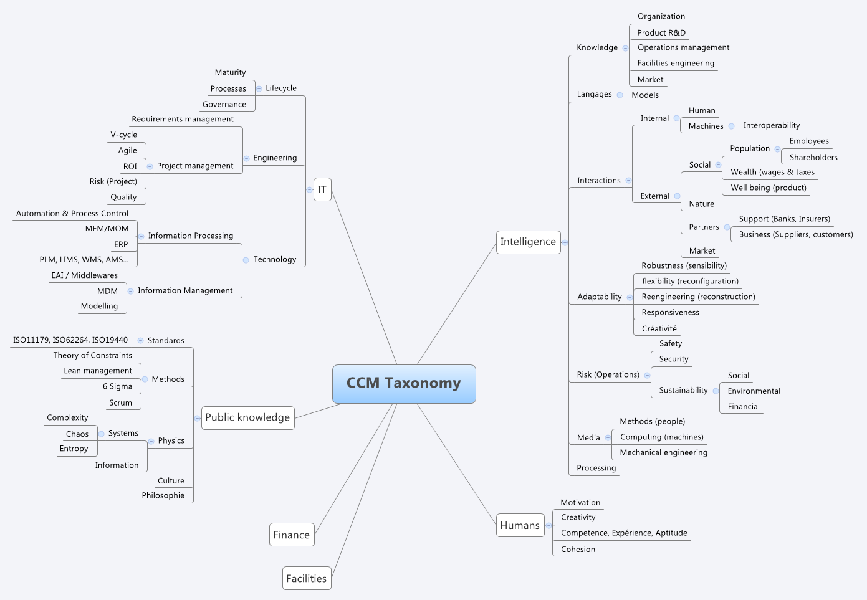
Development of an enterprise system taxonomy
Discussing the CCM taxonomy development

Slide 20
Thank You !

