Slide 1
MI - Enterprise Language Standards
04/2011

Slide 2
Introduction
ISO15000-5 UN/CEFACT CCTS
OPC UA
ISO15926
ISO15414
ISO19440
ISO62264/ISA-95 + IEC61512/ISA-88
ISO11179

Slide 3
Introduction
The Enterprise organism keeps morphing itself
  Achieving the Darwinian process of its existence by developing objective knowledge to its advantage
  Fighting entropy, securing survival, enabling progress
  Ensuring that thinking people and machines understand each other and the system they live in
Hypercritical complexity
  quantity and quality of interactions
  spouts “emerging properties”, Culture, Intelligence, Auto-organization
  Developing new, higher ranking behavior
  Not deductible from their individual components
The Syntropic Factory focuses on becoming a smarter organism
  Developing its “intelligence”

Slide 4
Conditions of intelligence
A product of complexity, Intelligence raises from
  Ability to develop knowledge
    Enabling cycling between subjective experience and objective knowledge
  Ability to share knowledge
    Enabling seamless storage and access to relevant knowledge
  Ability to interact
    Enabling understandable communications between components
  Individual intelligence
    Sophisticated components performing locally
    At the advantage of the whole system
Secondary level behavior
  Creativity
  Risk assessment and management
    Securing actions against uncertainty

Slide 5
Language
Objective knowledge is out of reach
  It exists independently of its actual understanding – by human, machines
Language is the means for handling knowledge
  Language defines basic concepts (vocabulary) and rules (grammar) for expressing knowledge
Existence of a language is a pre-condition for intelligence

Slide 6
Enterprise knowledge
Covers many domains
Addresses tangible and intangible information.
For Industrial facilities operations
  Tangible knowledge
    Resources and capabilities (equipment, people, material, energy…)
  Intangible knowledge
    Know-how not formalized
Enterprise knowledge covers
  Public knowledge
    Readily available
  Private knowledge
    Represents the enterprise essence
    Might need to be protected from competitors’ eyes

Slide 7
Enterprise language
Tangible outcome of the language:
  meaningful, non ambiguous messages for knowledge exchange, storage, retrieval
  Support the description of enterprise structural and behavioral aspects on the time scale
Must serve both Human and IT relationship
  Understandable by people and machines
  Machine, being notably stupid, need extended, precise formalism to understand

Slide 8
Elements of the enterprise language
Natural language accommodate most of human interactions
Machines need more formalism
The enterprise language is a formal ontology
  A semantic tree
  Defining concepts associated with lexicon (translations, synonyms,)
  Structured successively in
    simple abstract concepts i.e. « Identifier » « Description »
    General concepts i.e. « « activity », « Resource »
    business concepts as references for actual business entities mentioned in messages
  Describing relationships and value domains

Slide 9
Public knowledge and standards
Standards expose public knowledge
  Enterprise generic concepts (public knowledge) is well covered by available standards
Acquiring appropriate public knowledge is part of the enterprise knowledge / intelligence development
  Ignoring public knowledge forces to reinvent the wheel
  Leveraging public knowledge
    Saves effort and time,
    Catalyze private knowledge development,
    Accelerates intelligence development
Many overlapping standards, more or less focused
This study present some relevant standards to establish an enterprise language

Slide 10
Applicable standards
Reference | Title | Domains
ISO15000-5 UN/Cefact CC | ebXML - Core Componenet Technical Specification | ULO - Data structures for elementary concepts
OPC UA | OPC Unified Architecture | ULO - Neutral Upper level ontology
ISO15926 | Industrial automation systems and integration – Integration of lifecycle data for process plants | ULO - Upper level ontology of enterprise concepts
ISO15414 | Information Processing – Open Distributed Processing – Reference model – Enterprise language | ULO - Generic enterprise concepts Upper level ontology
ISO19440 | Contructs for enterprise modelling | Generic enteprise concepts
ISO62264 IEC61512 | Enterprise-control system integration Batch Control | Manufacturing operations specific concepts
ISO15531 (not studied) | Industrial automation systems and integration – industrial manufacturing management data | Manufacturing specific concepts
ISO11179 | Information Technology – Metadata registries | Semantic registry

Slide 11
Introduction
ISO15000-5 UN/CEFACT CCTS
OPC UA
ISO15926
ISO15414
ISO19440
ISO62264/ISA-95 + IEC61512/ISA-88
ISO11179

Slide 12
ISO15000-5 UN/CEFACT CCTS
ISO 15000 : Electronic business eXtensible Markup Language (ebXML)
  Part 5 is the UN/CEFACT Core Components Technical Specification (CCTS)
UN Cefact relevant work:
  Core Components Data Type Catalogue
  Core Components Technical Specification
  XML Naming and Design Rules Technical Specification

Slide 13
Core Components Data Type Catalogue
Amount | Ordinal
Binary Object | Percent
Code | Picture
Date | Quantity
Date Time | Rate
Duration | Ratio
Graphic | Sound
Identifier | Text
Indicator | Time
Measure | Value
Name | Video

Slide 14
  Core Components Technical Specification
Provides a way to identify, capture and maximize the re-use of business information to support and enhance information interoperability.
Focuses both on human-readable and machine processable representations of this information.
Semantic standardization is done in a syntax-neutral fashion.
  allows for the richness inherent in natural language to be used to create data and information exchange models that are devoid of computer-driven syntax limitations and requirements.
Captures a wealth of information about the business reasons for variation in data model and message semantics and structure.
  In the past, these variations have led to incompatible models and a subsequent lack of interoperability. The core components mechanism will allow identification of similarities and differences between these models.

Slide 15
UN/CEFACT CCTS Standards Stack
Business Transactions
UMM
R
e
g
i
s
t
r
y
EDIFACT
XML NDR
EDIFACT Syntax
XSD
XCDT
XML
UML Profile for CCTS
UML
Message Assembly
UCM
SBDH
Component Library ISO15000
Business Data Types
Core Components Technical Specification
Data Type Catalogue
ISO 11179
Context Categories
TMG (Techniques and Methodologies Group)
Note:
UML = Unified Modeling Language
UMM = UN/CEFACT Modelling Methodology
XSD = XML Schema Definition Language
XML = Extensible Markup Language
XMI = XML Metadata Interchange
XCDT = XML Expressed Core Data Types
BCSS = Business Collaboration Specification Schema
UCM = Unified Context Methodology
SBDH = Standard Business Document Header
TBG (Trade Business Group)
ATG (Applied Technologies Group)
ICG
Implicit parts of UN/CEFACT Standards
Non UN/CEFACT Standards

Slide 16
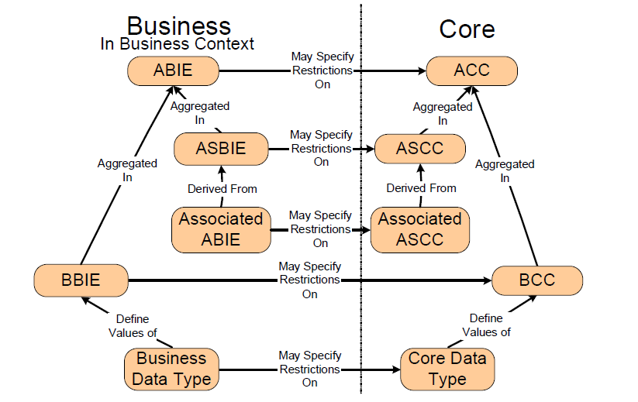
Relationship between core abstract and business types

Slide 17
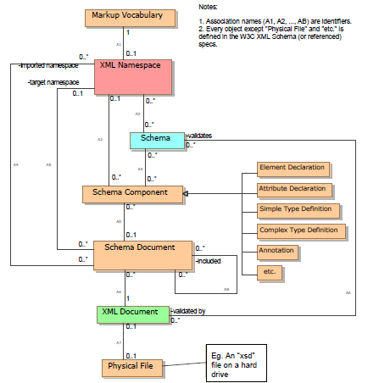
  XML Naming and Design Rules Technical Specification
Good Design Practices for XML Schemas
  XML Schemas architecture principles
  Recommended usage of XSD primitives
  XML Schema files handling
  XML instances handling

Slide 18
Introduction
ISO15000-5 UN/CEFACT CCTS
OPC UA
ISO15926
ISO15414
ISO19440
ISO62264/ISA-95 + IEC61512/ISA-88
ISO11179

Slide 19
OPC UA main modelling concepts
OPC UA offers an infrastructure to facilitate information exchange
  In industrial application areas
    Field devices, Control systems, MES systems, ERP systems
  Addressing
    Modeling language for describing structures, behaviour, semantics
      Standard, extensible models
    Messaging concepts to interact between applications
    Communication concepts to handle data transfer
OPC UA provides
  Data modelling framework
  Service set for accessing data

Slide 20
Elements of OPC UA (Node classes)
Main classes | subclasses | subclasses | Defined by | Predefined
View
Object |  |  | ObjectType
Type Definition | ObjectType | Folder type |  | DataTypeSystem
 |  | ModellingRule Type
 |  | EventType |  | Next slides
 | DataType |  |  | Next slides
 | VariableType |  | Data Types | DataTypeDictionary,
 | Reference Type |  |  | Next slides
Variable | Property |  | Data Types
 | DataVariable |  | Data Types
Methods

Slide 21
OPC UA standard Attributes
AccessLevel | IsAbstract
ArrayDimensions | MinimumSamplingInterval
BrowseName | NodeClass
ContainsNoLoops | NodeId
DataType | Symmetric
Description | UserAccessLevel
DisplayName | UserExecutable
EventNotifier | UserWriteMask
Executable | Value
Historizing | ValueRank
InverseName | WriteMask

Slide 22
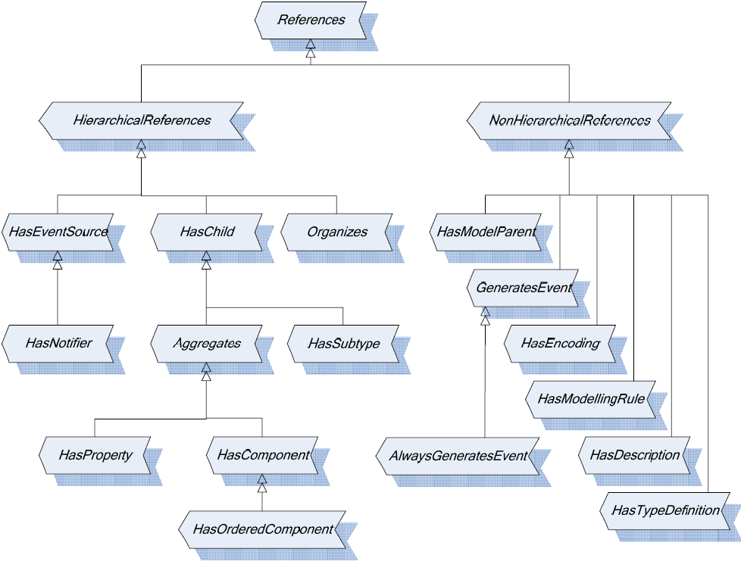
OPC UA Standard Reference types

Slide 23
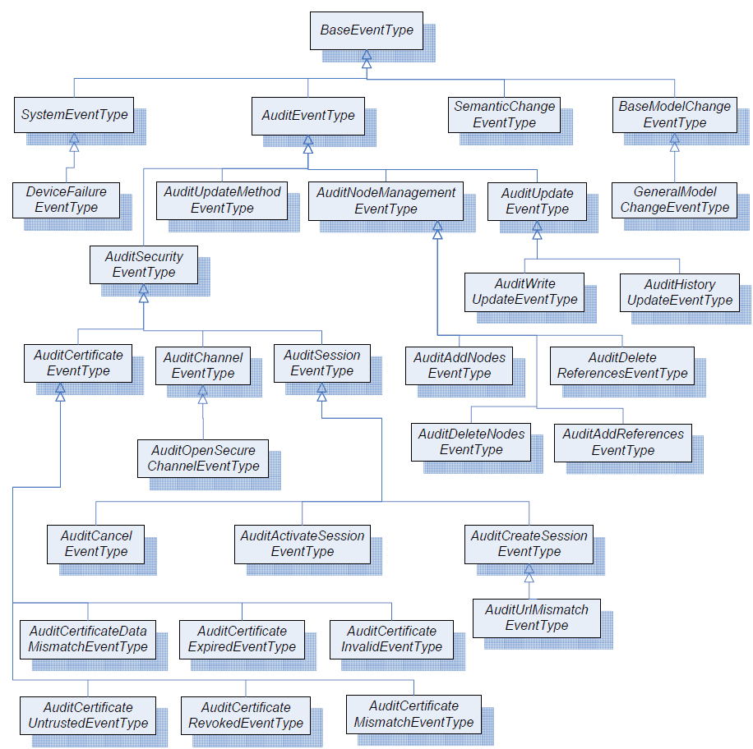
OPC UA standard event types

Slide 24
OPC UA standard Services
Service set
Discovery | Discover Servers: FindServers, GetEndpoints, RegisterServer
SecureChannel | Open / close secure communication (lower level – protocol dependent)
Session | Open / close Session
Attribute | Read / write data (including history)
Subscription | Subscribe to data (receive data)
MonitoredItem | Subscribe to data (specifying which data to subscribe to)
View | Browsing
Query | Querying
NodeManagement | Add / delete Nodes and References
Method | Method calls

Slide 25
Introduction
ISO15000-5 UN/CEFACT CCTS
OPC UA
ISO15926
ISO15414
ISO19440
ISO62264/ISA-95 + IEC61512/ISA-88
ISO11179

Slide 26
ISO15926 background
ISO 15926 “Industrial automation systems and integration—Integration of life-cycle data for process plants including oil and gas production facilities“
  Part of the European community program « ESPRIT »
  EPISTLE consortium
  Supported by POSC Caesar Association
    Petrotechnical Open Software Corporation
    Oil & Gas, Norway
  OWL implementation
Focused on reference data lifecycle
Wide applicability
  Focuses on describing industrial facilities
  Based on an upper level ontology of large expressiveness

Slide 27
ISO15926 - Upper level types
Class
Thing
 | Possible Individual |  |  | Pump #1234
 | Abstract object
 |  | Class |  | Pump
 |  | Relationship |  | Pump #1234 is member of Pump
 |  |  | Composition of Individual
 |  |  | Connection of Individual
 |  | Multi-dimensional object |  | List of « Things »

Slide 28
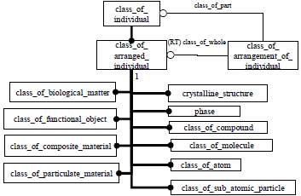
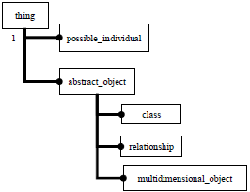
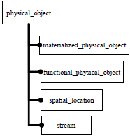
ISO15926 - examples
Upper level types
Physical object
Material organization

Slide 29
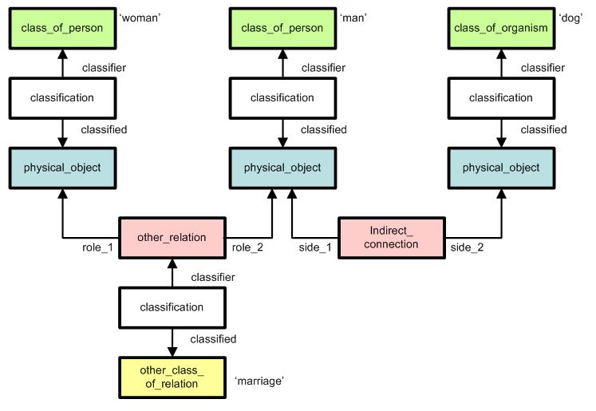
ISO15926 Example

Slide 30
Introduction
ISO15000-5 UN/CEFACT CCTS
OPC UA
ISO15926
ISO15414
ISO19440
ISO62264/ISA-95 + IEC61512/ISA-88
ISO11179

Slide 31
ISO15414
« Information Technology – Open Distributed Processing Reference model – Enteprise Language »
Developed by ITU
  International Telecommunication Union – ITU-T X.911
Proposed « Enterprise language » in the more global context of RM-ODP
  Reference Model of Open Distributed Processing
  ISO10746-1/2/3/4 - ITU-T X901/2/3/4

Slide 32
ISO15414 concepts
System concepts
  Scope, Field of Application
Community concepts
  Onjective, Community object
Behaviour concepts
  Actor, Artefact, Resource, Interface Role, Process, Step
Policy concepts
  Policy, Authorization, Violation
Accountability concepts.
  Party, Commitment, Declaration, Delegation, Evaluation, Prescription, Agent, Principal

Slide 33
ISO15414 Structuring rules
Community rules
Enterprise object rules
Common community types
Lifecycle of a community
Objective rules
Behaviour rules
Policy rules
Accountability rules

Slide 34
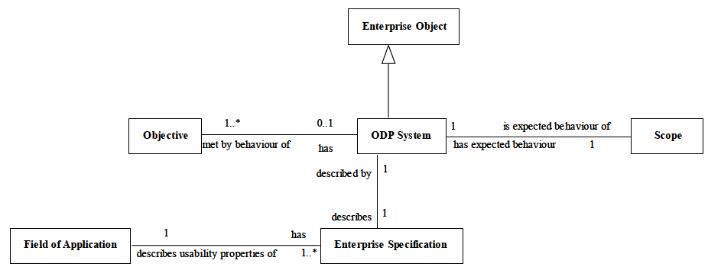
System concepts

Slide 35
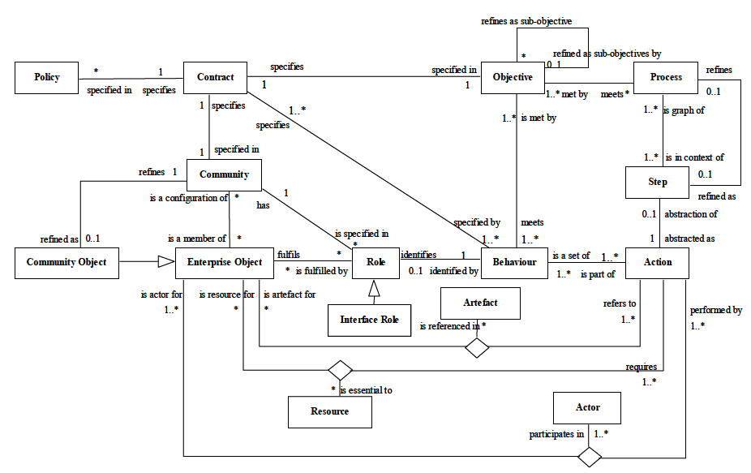
ISO15414 – Community and Behaviour concepts

Slide 36
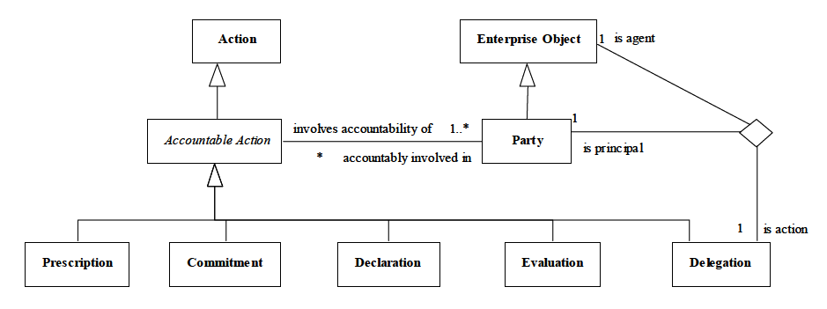
Policy concepts

Slide 37
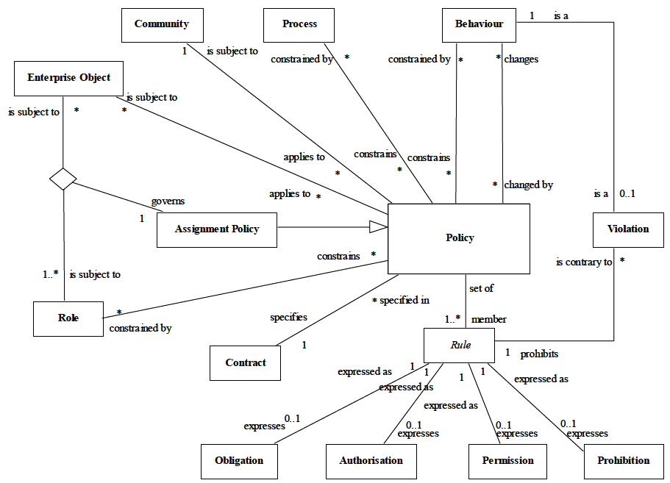
Accountability concepts

Slide 38
Introduction
ISO15000-5 UN/CEFACT CCTS
OPC UA
ISO15926
ISO15414
ISO19440
ISO62264/ISA-95 + IEC61512/ISA-88
ISO11179

Slide 39
ISO19440
Defines the generic concepts for enterprise models
  provides common semantics
  enables the unification of models developed by different stakeholders
These concepts can be
  specialized / organized for specific purposes,
  used for developing particular models for a particular enterprise.
General requirements computer supported enterprise modeling
  Business Processes model (dynamics, functions, information, resources, organization and responsibilities)
  Detailing and qualification of enterprise components for a specific enterprise,
  Support for management of change,
  end-user-oriented representation to enable operational use.

Slide 40
ISO19440 « constructs »
The standard describes in detail the following concepts
  Function- and process-related:
    Domain, Business Process, Enterprise Activity, Event
  Information-related:
    Enterprise Object, Enterprise Object View, Order, Product
  Resource-related:
    Capability, Operational Role, Resource, Functional Entity
  Organization-related:
    Person Profile, Organizational Role, Organization Unit, and Decision Centre.
These concepts can be specialized
  Any enterprise concept shall be derivable from this list

Slide 41
Example of « Business Process » - Header
Construct label | [‘BP‘]
Identifier | [<model-unique string>]
Name | [name of Business Process instance in the form: <adjective> <noun>, where <noun> relates to the scope of the Business Process, <adjective> qualifies the business Process instance]]
Design Authority | [<identifier> / <name> of Organisational Unit or Organisational Cell with the authority to design/maintain this particular instance]

Slide 42
Example of « Business Process » - Descriptives
DESCRIPTION | [textual description]
OBJECTIVES | [non-empty list of Objectives to be fulfilled by the Business Process instance
CONSTRAINTS | ['NIL' or list of Constraints imposed on the BP instance]
PERFORMANCE INDICATORS | ['NIL' or list of the metrics or measures by which achievement of the objectives can be assessed]
DECLARATIVE RULES | ['NIL' or list of Declarative Rules applicable to this Business Process instance]
INPUTS | [non-empty list of <identifier> / <name> of all Object View instances, occurrences of which can be received by occurrences of the Business Process instance] [non-empty list of <identifier> / <name> / <source domain> of all Events , instances of which can be received by occurrences of the Business Process instance]

Slide 43
Example of « Business Process » - Descriptives
OUTPUTS | [non-empty list of <identifier> / <name> of all Object View instances, occurrences of which can be sent by occurrences of the Business Process instance] [non-empty list of <identifier> / <name> / <sink domain> of all Events, instances of which can be sent by occurrences of the Business Process instance]
PROCESS BEHAVIOUR | [non-empty set of Behavioural Rules expressed using the syntax defined for Process Behaviour as defined in 6.3.3]
PRIORITY | [Integer in a range <min, max> where min and max are integers representing the lowest and highest priorities respectively]

Slide 44
Example of « Business Process » - Relationships
WHERE USED | [<identifier> / <name> of the Domain employing this Business Process instance]
CONSISTSOF | [non-empty list of <identifier> / <name> of all Business Process and Enterprise Activity instances that are employed directly (i.e. at the next level of decomposition) by this Business Process instance]
Operation Responsibility | [<identifier> / <name> of Organisational Unit or Organisational Cell with responsibility for operation of this instance
Operation Authority | [<identifier> / <name> of Organisational Unit or Organisational Cell with authority for operation of this instance]

Slide 45
Introduction
ISO15000-5 UN/CEFACT CCTS
OPC UA
ISO15926
ISO15414
ISO19440
ISO62264/ISA-95 + IEC61512/ISA-88
ISO11179

Slide 46
ISA-88/ISA-95 set of standards
US standard | INTL Standard | Sub Title
ANSI/ISA-88.00.01: 1995 | IEC61512-1: 1997 | Models and Terminology”
ANSI/ISA-88.00.02: 2001 | IEC61512-2: 2001 | Data structures and guidelines for languages
ANSI/ISA-88.00.03: 2003 | IEC61512-3: 2008 | General and Site Recipe - Models and Representation
ANSI/ISA-88.00.04: 2006 | IEC61512-4: 2009 | Batch Production Records
ISA Draft88.00.05 | - | Implementation Models & Terminology for Modular Equipment Control
ANSI/ISA-95.00.01: 2000 | IEC/ISO62264-1: 2003 | Models and Terminology”
ANSI/ISA-95.00.02: 2001 | IEC/ISO62264-2: 2004 | Data Structures and Attributes”
ANSI/ISA-95.00.03: 2005 | IEC/ISO62264-3: 2006 | Activity Models of Manufacturing Operations Management
ISA draft 95.00.04 | - | Object Models and Attributes of Manufacturing Operations Management)
ASNI/ISA-95.00.05: 2007 | IEC/ISO62264-5: 2009 | Business to Manufacturing Transactions

Slide 47
ISA88 snapshot
Object Design of automation applications
  Reuse, Knowledge Management, Robustness
Flexible Design of automation applications - No programming required for
  Modification of recipes, making different products with the same facility
  Using alternate equipment for the same production step
  Sequencing production runs for different products
Interoperability
  Assembling software components from different origins
Product Industrialization
  Neutral specification of product physico-chemical transformations
  Conversion of this specification into operating procedure for target facilities
Production Information
  Data structures for production information history
  Includes several ISA95 models
Applications
  Initially designed for Batch processes, but applicable to any type of process
  Functional specification, batch managers, historians, PDM/PLM

Slide 48
ISA95 snapshot
B2M: Collaboration Business / Execution
  Communication between execution systems (MES/MOM, DCS, MMS, LIMS, WES, SCADA,…) and business systems (ERP, SCM)
  Master data management
MES/MOM : Functional definition
Data and Activity models
  Description of resources, capability, products, work order requests and reports
  Definition of operation management activities (MES)
Applications:
  User requirements and functional specification of MES and B2M interfaces
  Native B2M connectors - MES/ERP (B2MML)
  Possible basis for developing MES applications and software…

Slide 49
ISA-88/ISA-95 modelling overview
ISA-95
Product Asset Management
Inventory Asset Management
Physical Asset Management
Human Asset Management
IT Asset Management
ISA-88
TOGAF
ITIL
ISA-88 + ISA-95

Slide 50
ISA88 Product model* (Processing Requirement)
Process
A Process is made up of an ordered set of one or more Process Stages
Process
Stage
A Process Stage is made up of an ordered set of one or more Process Operations
A Process Operation is made up of an ordered set of one or more Process Actions
Process
Operation
*Nota : called “Process Model” in ISA88
Process
Action
Product Asset
Inventory Asset
Physical Asset
Human Asset
IT Asset

Slide 51
Resource models (Structural description)
The resource asset models (Personnel, Equipment, and Material) are based on the ISA95 breakdown.
All these resources share a similar pattern. Equipment and Material are indeed the same entity: A “machine” can be:
  A “Physical Asset” for the company that makes products with it,
  An “Inventory Asset” for the company that makes them (finish product) or sell / distributes it
Product Asset
Inventory Asset
Physical Asset
Human Asset
IT Asset

Slide 52
ISA95 Material Model
Product Asset
Inventory Asset
Physical Asset
Human Asset
IT Asset

Slide 53
ISA95 extended physical model (Actual Facility layout)
ENTERPRISE
BATCH
PROCESS
(ISA88)
CONTINUOUS
PROCESS
DISCRETE
PROCESS
WAREHOUSE
SITE
AREA
WORK
CENTER
PROCESS
CELL
PRODUCTION
UNIT
PRODUCTION
LINE
STORAGE
ZONE
WORK UNIT
UNIT
UNIT
WORK CELL
STORAGE
UNIT
EQUIPMENT
MODULE
Product Asset
Inventory Asset
Physical Asset
Human Asset
CONTROL
MODULE
IT Asset

Slide 54
ISA95 Equipment Model
Product Asset
Inventory Asset
Physical Asset
Human Asset
IT Asset

Slide 55
ISA95 Personnel Model
Personnel
Class
Person
0..n
0..n
< Defined by
0..n
Is tested
by a >
0..n
Has
properties
of >
Is tested
by a >
Has
values for >
0..n
0..n
Qualification
Test
Specification
< Records the
execution of
Qualification
Test
Result
0..n
0..n
Defines a
procedure for
obtaining a >
Is tested
by a >
0..n
0..n
Personnel
Class Property
0..n
0..n
Person
Property
< Maps to
Product Asset
Inventory Asset
Physical Asset
Human Asset
IT Asset

Slide 56
ISA88 Procedural model (Equipment/Product Interactions)
Procedure
A Procedure is made up of an ordered set of one or more Unit Procedures
Unit
Procedure
A Unit Procedure is made up of an ordered set of one or more Operations
An Operation is made up of an ordered set of one or more Phases
Operation
Phase
Product Asset
Inventory Asset
Physical Asset
Human Asset
IT Asset

Slide 57
ISA95 Segment Model
0..n
has an execution dependency on
Process
Segment
0..n
0..n
Process
Segment
Dependency
is a collection of
May be made up of
0..n
0..n
0..n
0..n
0..n
Process
Segment
Parameter
Personnel
Segment
Specification
Equipment
Segment
Specification
Physical Asset
Segment
Specification
Material
Segment
Specification
0..n
0..n
Has properties
of
Has properties
of
Has properties
of
Has properties
of
Is assembled
from
May be made up of
0..n
0..n
0..n
0..n
Personnel Segment
Specification
Property
Equipment Segment
Specification
Property
Physical Asset
Segment
Specification
Property
Material Segment
Specification
Property
0..n
Corresponds
to element in
0..n
Corresponds
to element in
0..n
Corresponds
to element in
0..n
Corresponds
to element in
1..1
1..1
1..1
1..1
Personnel
Model
Equipment
Model
Physical Asset
Model
Material
Model
Product Asset
Inventory Asset
Physical Asset
Human Asset
IT Asset

Slide 58
ISA95 Operational Activity Model
1.Detailed
scheduling
8. Resource
management
5. Tracking
2. Dispatching
6. Analysis
7. Definition
management
4. Data
collection
3. Execution
Production
Other
Quality Control
Inventory
Product Asset
Inventory Asset
Physical Asset
Human Asset
IT Asset
Maintenance

Slide 59
ISA88 & ISA95 Objects in Production Lifecycles
3. Operations
Schedule
Batch list
Requests / Control Recipes
Segments / RPE
1. Product
Dévelopment
2. Engineering
Product Definition
Recipe
Segments
PE/RPE
Segments
EPE
Capability
Resources
Personnel/Equipment/Material
Equipment entity / Formula

Slide 60
Continuous modeling workflow
P&ID
R&D
CCM
Rules & Tools
Use
Build
Improve
1b. Physical
Modelling
1a. Product
Modelling
1a. Inventory
Modelling
1c. Human
Modelling
Object classes and models repository
Use
Build
Improve
2. Equipment Control Modelling
3. Process Procedural Modelling
4. Segments Modelling
IT modelling
5. Operation Process
Modelling

Slide 61
Continuous modeling workflow
P&ID
R&D
Goverance
Enabling
CCM
Rules & Tools
Use
Build
Improve
1b. Physical
Modelling
1a. Product
Modelling
1a. Inventory
Modelling
1c. Human
Modelling
Persistence
Object classes and models repository
Use
Build
Improve
ISA88/95
ISA95
2. Equipment Control Modelling
3. Process Procedural Modelling
ISA88
4. Segments Modelling
ISA95
IT modelling
5. Operation Process
Modelling

Slide 62
Interactions Hierarchy
Business Processes
Business
Business Activities
Operations Processes
(ISA-95,
MES)
Operations Activities
Exécution
Physical Processes
Recipes, routing
(ISA-88,
Equipment
Control)
Operating Instructions
Procedural Elements

Slide 63
Examples of Description standards
Business / Operation process Description:
BPMN, OSSAD, UML
Schedule
Requests / Recipes
Product Definition:
PPC
Physical Process
Description
: PFC
Segments / RPE
Product Definition
Segments
PE/RPE
Segments
EPE
Capability
Resources
Personnel / Equipment / Material

Slide 64
ISA-88/95 Modeling elements
Domain | Model | Std | Information elements
Product Asset | Process Product | ISA88 ISA95 | Product Hierarchy Product Definition
Inventory Asset | Material | ISA95 | Material Resources
Equipment Asset | Physical Equipment | ISA88 ISA95 | Equipment Hierarchy Equipment Resources
Human Asset | Personnel | - ISA95 | Personnel Hierarchy Personnel Resources
Equipment Control | Procedural | ISA88 | Functional Hierarchy Equipment Procedural Elements
Physical Process Control | Procedural | ISA88 | Physical Processes / Procedural Elements Physical Process Transform Components
Physical Process Mngt | Segment | ISA95 | Segments
Operation Process Mngt | Operation Activity | ISA95 | Operation Processes Activities / Tasks

Slide 65
Introduction
ISO15000-5 UN/CEFACT CCTS
OPC UA
ISO15926
ISO15414
ISO19440
ISO62264/ISA-95 + IEC61512/ISA-88
ISO11179

Slide 66
ISO11179
A semantic registry records all concepts as lexicon of unique terms
They can be categorized i.e.
  Basic vocabulary
  Abstract concepts (not specific to a particular business context)
    Simple, Enumerated or Non enumerated
    Complex
  Business concepts (meaningful in specific situations)
ISO11179
  Supports semantic definition
  Also register data representation
    occurrences of concepts in actual situations – IT solution, local terminologies
  Handles reference data management
  Define principles for consistent naming and clear descriptions

Slide 67
ISO 11179
Titre: Information technology — Metadata registries (MDR)
  Part 1: Framework
    Vue d’ensemble
  Part 2: Classification
    Extrait du méta-modèle partie 3 concernant la classification
  Part 3: Registry metamodel and basic attributes
    Définit le meta-modèle pour gérer les données de référence
  Part 4: Formulation of data definitions
    Définit des principe pour exprimer clairement les définitions
  Part 5: Naming and identification principles
    Définit des principes d’identification et de nommage
  Part 6: Registration
    Définit le processus d’enregistrement des méta-données

Slide 68
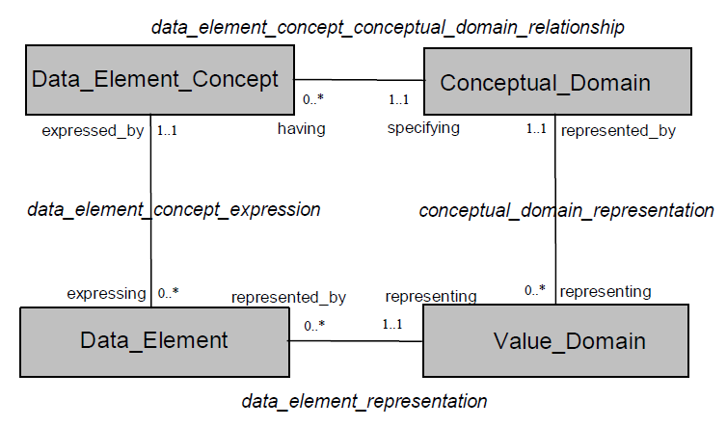
ISO11179 meta model
« Value »
« Measure »
« PT104 »
« Temperature »

Slide 69
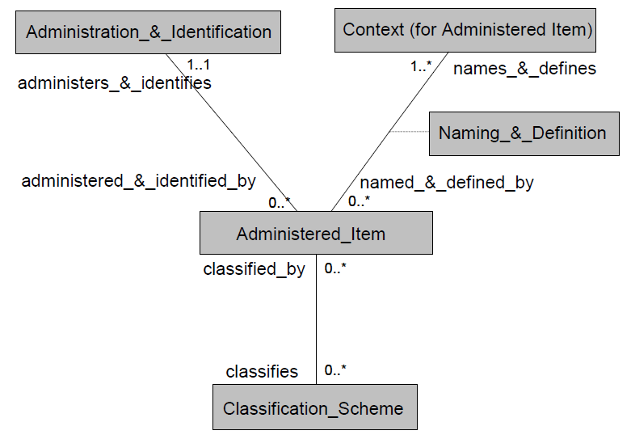
ISO11179 data administration

Slide 70
Introduction
ISO15000-5 UN/CEFACT CCTS
OPC UA
ISO15926
ISO15414
ISO19440
ISO62264/ISA-95 + IEC61512/ISA-88
ISO11179
Next steps

Slide 71
Interoperability is a key element for enabling interactions
  Developing knowledge and systemic intelligence of the enterprise
Language
  Is the precondition for intelligence
  Transform interfaces in intereactions
A significant public knowledge is available
  From ISO and other standardization bodies
  Helping to set a consistent basis for an Enterprise language
Enterprise language
  Allows to manage and leverage enterprise knowledge
    Including Master Data
  Provides global semantic reference refered to in collaboration
  Provides formal concepts for interoperability
    Meaningful messages between actors – People and IT

Slide 72
Thank You !

