Slide 1
MI - Make intelligence actionable
VSM (preliminary)
04/2011

Slide 2
Agenda
Short overview
Notes:
To be developed
The Fractal Enterprise
Cybernetics and Viable System Model
Complexity and Variety
Nature of interactions
Examples

Slide 3
Fractal model to describe a complex world
Benoit Mandelbrot’s fractals are a graphical tool to describe complex nature’s shapes
The same approach is relevant to the systemic view of the world
A complex system – like an enterprise – is part of other systems, themselves embedded in larger systems
  The Universe
    The Milky way galaxy
      The solar system
        The Earth system
          The multinational company
            The main business entity
              The main departments : R&D, sales, marketing, production,
                A given facility...
            The nations

Slide 4
What is a system?
The definition of the boundary of a system is mainly up to the observer
  Common sense suggests some breakdown as exposed before
  In all cases, this breakdown has the only purpose and relevancy in the context of our search of understanding and controlling our environment
Actually, the chosen breakdown establishes
  Hierarchy levels
    Normally consistent
    Level might be skipped for simplification purposes
  Selected boundaries
    There are often gray area between interacting systems, with possibly shared components

Slide 5
Viable System Model (VSM)
Developed by Stafford Beer until 1972
The VSM, as any attempt to satisfy our thirst of truth has no intrinsic, absolute value
  Beer himself presents VSM as a guideline for checking systemic constituency for a viable system
  It is yet a valuable map to capture more understanding
The VSM was build upon the well recognisable systemic patterns of biological organisms.
The VSM model is valid at any level of recursion that is considered
The VSM model defines 5 “systems” (or more exactly layers/facets) in a given “system recursion”

Slide 6
Viable System Model
VSM | Beer | Other | Operational department
System 5 | Higher Management | Policy | Steering
System 4 | Environment of decision - War room | Development | Transformation
System 3 | Directorate | Delivery management & monitoring | Planning
System 2 | Regulatory center | Coordination | Coordination
System 1 | Activity | Operations Implementation | Implementation Support Operations

Slide 7
Management unit
Variety increases from Management -> Operations -> Environment
Environment
Operations
Management

Slide 8
Separate the 3 domains
Environment
Operations
Management

Slide 9
Introducing variety/complexity control: filters and amplifiers
Environment
Operations
Management

Slide 10
The full VSM
Meta-
system
5 Policy
4 Development
3 Delivery
2 Coordination
Operations
Operations

Slide 11
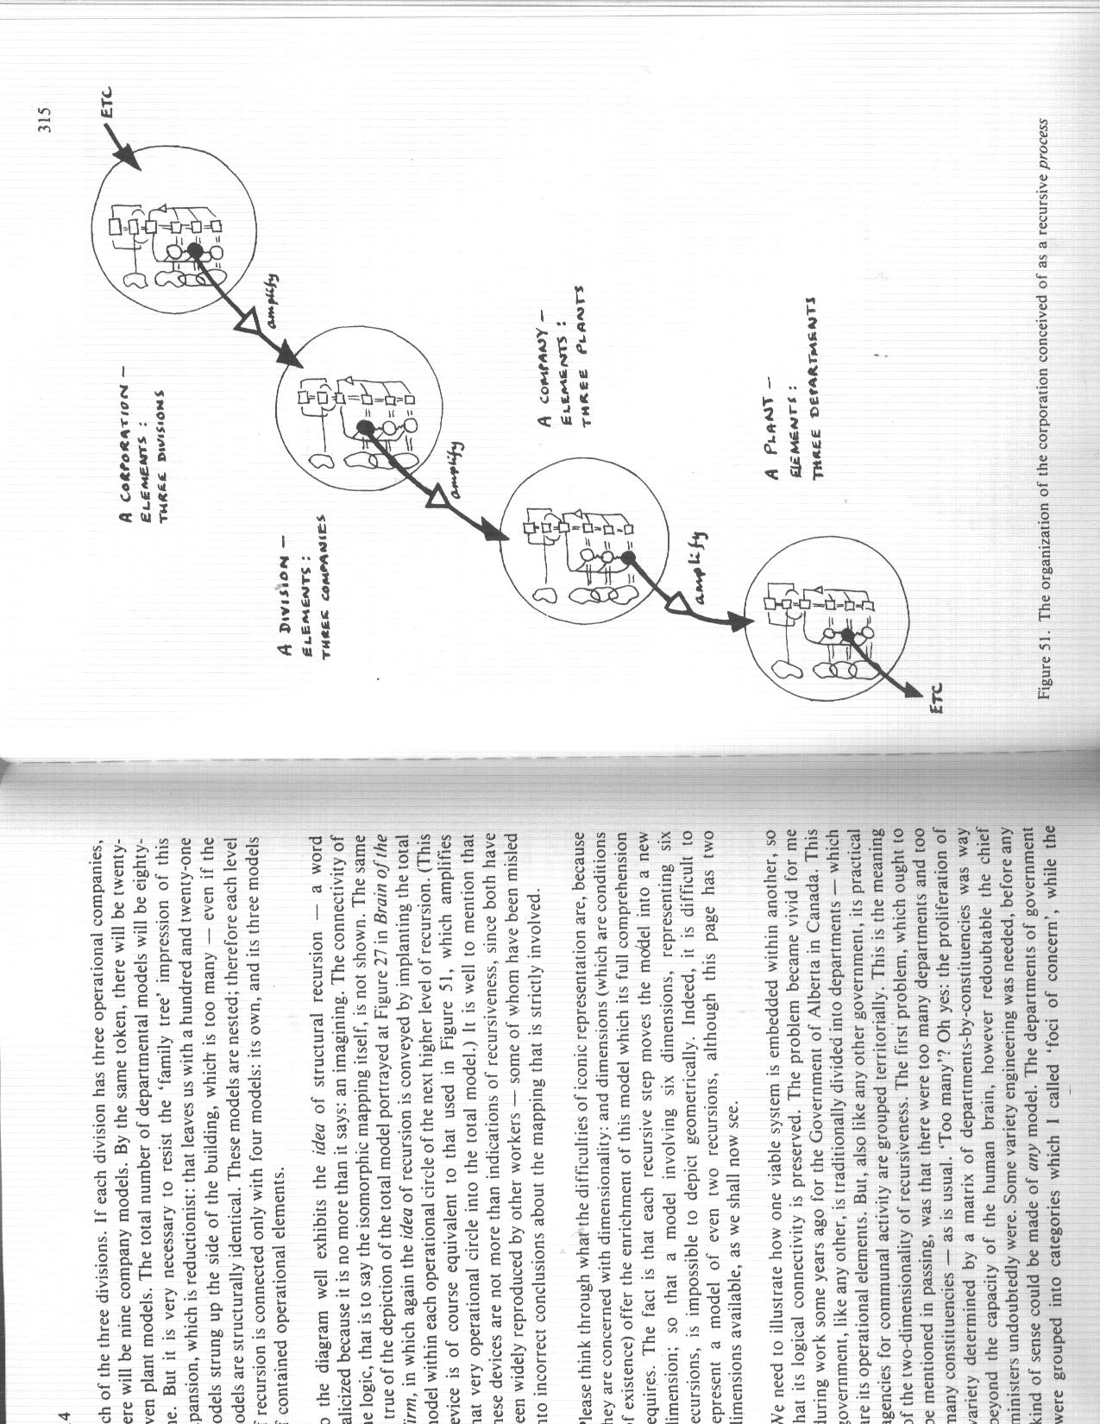
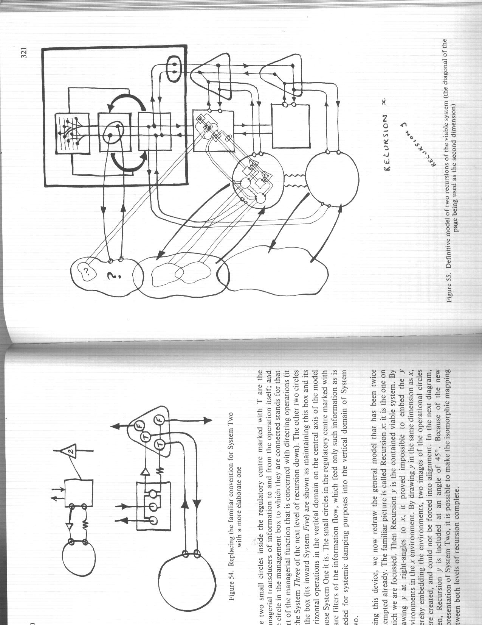
From “The Heart of The Enterprise”

Slide 12
Example: General structure of an industrial enterprise
Marketing
Finances
HR
Corporation
Engineering
Research
Production
Distribution
& sales
Research
departments
Production
Plants
Distribution
centers

Slide 13
Example: IT support to Production - detail
Corporation
Engineering
Steering
Production
Planning
Transformation
Steering
ITD
Transformation
Planning
Steering
Coordination
Contractor
Transformation
Planning
Operations
Steering
Coordination
Transformation
Planning
Research
Operations
Coordination
..
Operations

Slide 14
IT support to Production – VSM relationships
ITD
Production
ITD VSM5
Steering
Production VSM5
Steering
IT
Environment
Production
Environment
DISI VSM4
Transformation
Production VSM4
Transformation
ITD VSM3
Planning
Production VSM3
Planning
ITD VSM2
Coordination
Production VSM2
Coordination
ITD VSM1
Implementation
Production VSM1
Operations

Slide 15
VSM fit with Business/IT CCM Convergence Processes
Steer
Production
Steer
ITD
(5) Lead Production
(5) Lead ITD
Transform ITD
(4)
Run
ITD
Transform Production(4)
Plan (3)
Maintain
Architecture
Coordinate (2)
Manage Requirements
Build (1)
Deploy (1)
Run
Production
Support (1)
Operate
(1)

Slide 16
VSM Dynamic performance management
VSM4
(Transform)
Organizational
Performance
Potentiality
Latent
Performance
VSM3
(Manage)
Capability
VSM2
(Coordinate)
Operational
Performance
VSM1
(Execute)
Actuality

Slide 17
VSM performance metrics
Metrics | Calculation | Level | Meaning
Organizational performance | Latent / Operational performance | VSM 2/3/4 | Ability to close the strategic gap
Latent Performance | Capability / Potentiality | VSM 3/4 | Willingness to close the strategic gap
Operational Performance | Actuality / Capability | VSM 2/1 | Actual Efficiency
Potentiality | Any metrics | VSM 4 | What we could deliver with willingness +realistic changes
Capability | Any metrics | VSM 3 | What we are capable to deliver in the current conditions
Actuality | Any metrics | VSM 1 | What we currently deliver
Read bottom up!

Slide 18
Further reading
Stafford Beer (1926 – 2002)
  The Brain of the Enterprise
  The Heart of the Enterprise
Patrick Hoverstadt
  The Fractal Organization

