Slide 1
Performance management for digital transformation
Jean Vieille, Industrial systems control
j.vieille@syntropicfactory.com
Second 4P Factory online Seminar
Wednesday 16th March 2016
Notes:
Abstract. Increasing dynamics of industrial production (supply chain volatility, new products, re-engineering of facilities and organization) is both caused and addressed by information technologies. Industrial IT needs to follow this ongoing transformation of enterprises and to take advantage of new IT technologies.
The "digital transformation” process objective is to best serving business objective and enterprise goals. It is implicitly or explicitly continuous even if showing discontinuities during large projects execution.
The performance of this process needs to be managed in order to focus efforts and to adjust budgets.
Performance management complements direct control by influencing behaviour, which is a way of fulfilling the “Law of requisite variety” that allows high level, low complexity entities (management) to control lower level, high complexity entities (operations) in either form of decision hierarchy.
To ensure success and survival of the enterprise, (local) performance targets of subsystems need to be aligned with global enterprise objectives. The concept of Overall Interactive Enterprise Efficiency helps qualifying these objectives and establishing this alignment.
Performance management must set current and long term targets to highlight respective responsibility of operational achievement and resource transformation investment.
Finally, performance management shall identify and resolve conflicts that spring from local viability fights triggered by sensible performance objectives.
A real life use case illustrates some of these exposed aspects of “digital transformation” performance management.
Keywords: IT Transformation, Performance management, management, Investment, Entropy, Complexity management, Viable system model, Fractal enterprise, Behaviour control, Conflict resolution

Slide 2
Agenda
IT transformation
Enterprise control
Performance management
Use case

Slide 3
Context
Hyper-connected World
  Increasing complexity, opportunities
Enterprises keep morphing to adapt to the changing environment
IT keeps progressing, pushing new technologies and hypes to support them
Industrial IT is aging, intricate
  Need to improve IT support to business,
  Need to leverage opportunities and technologies
  Without compromising operations, limiting risks

Slide 4
Questions
How to handle IT transformation ?
  To serve business
  While leveraging technology
How to link IT improvement to enterprise bottom line ?
  Budget for IT operations
  Budget for projects
  Priorities

Slide 5
IT at the heart of enterprise
Energy
Matter
Product
Y
Information
 | Energy | Information
Pre-industry | Human, animal | Human
Mechanization | Machine | Human
Automation | Machine | Computer
Smart Industry
Industrie 4.0
Industrie du Futur
Electro-mechanics
Pneumatics Electronics
Informatics
IoT
BigData
Mobility Networks

Slide 6
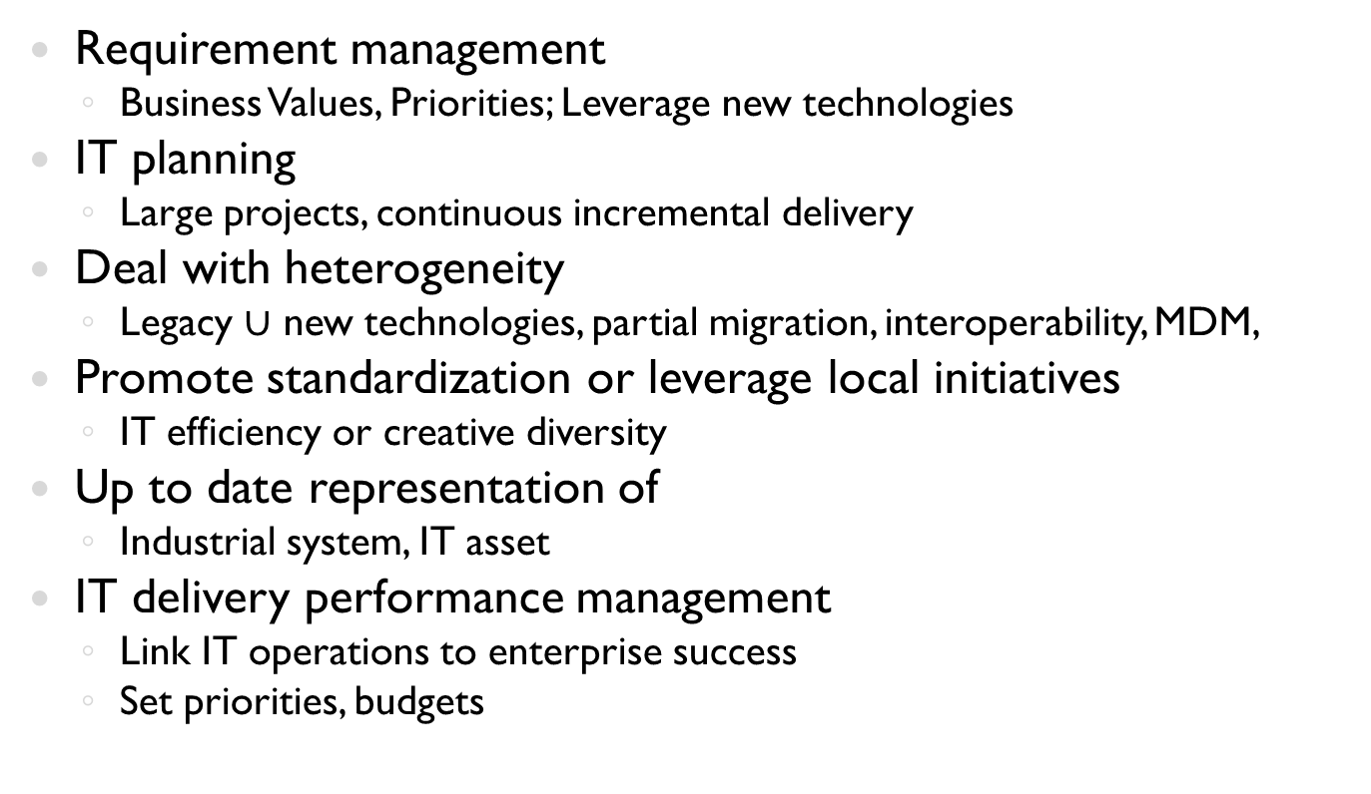
IT transformation Challenges
Requirement management
  Business Values, Priorities; Leverage new technologies
IT planning
  Large projects, continuous incremental delivery
Deal with heterogeneity
  Legacy $∪$ new technologies, partial migration, interoperability, MDM,
Promote standardization or leverage local initiatives
  IT efficiency or creative diversity
Up to date representation of
  Industrial system, IT asset
IT delivery performance management
  Link IT operations to enterprise success
  Set priorities, budgets

Slide 7
VSM 5,4
Policy, Global transformation
Strategy, Goal
Resource allocation
VSM 4
IT Transformation
(recursion)
5. Industrial
system model
2. IT planning
monitoring
Performance
Technology
awareness
Global IT Transformation
1. Requirement management
2.2 Development
2.3
Deployment
2.1 Technology - platform
4. IT assets and configurations
Business requirements,
Corrective maintenance
VSM 1,2,3
Operations
Local IT Transformation
(recursion)
3. Local realizations
Operations
Supported by IT

Slide 8
Agenda
IT transformation
Enterprise control
Performance management
Use case

Slide 9
Complexity
Very complex
Complex
Environment
Enterprise
Goal
???
Make money
Suppliers, Customers, Contractors, Partners
IRS , Regulations
Natural, Social environment
Market, Politics, Macroeconomics
Employees, shareholders
Bankers, Insurers
HR, Marketing,
R&D, Engineering, IT
Sales, Sourcing
Finance, Communication
Planning, Production, Logistics

Slide 10
Complexity control
Amplifier
C1/C2
C2/C3
Environment
C2
Operations
C3
C1
Management
C2/C1
C3/C2
Filter
C1 >> C2 >> C3
Law of Requisite Variety (W.R. Ashby) :
Variety of the controlling system >= Variety of the controlled system
Variety = number of possible states = f(complexity)
en.wikipedia.org/wiki/Complexity
en.wikipedia.org/wiki/Variety_(cybernetics)

Slide 11

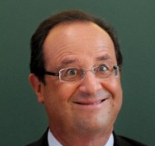

Take a Country

Slide 12

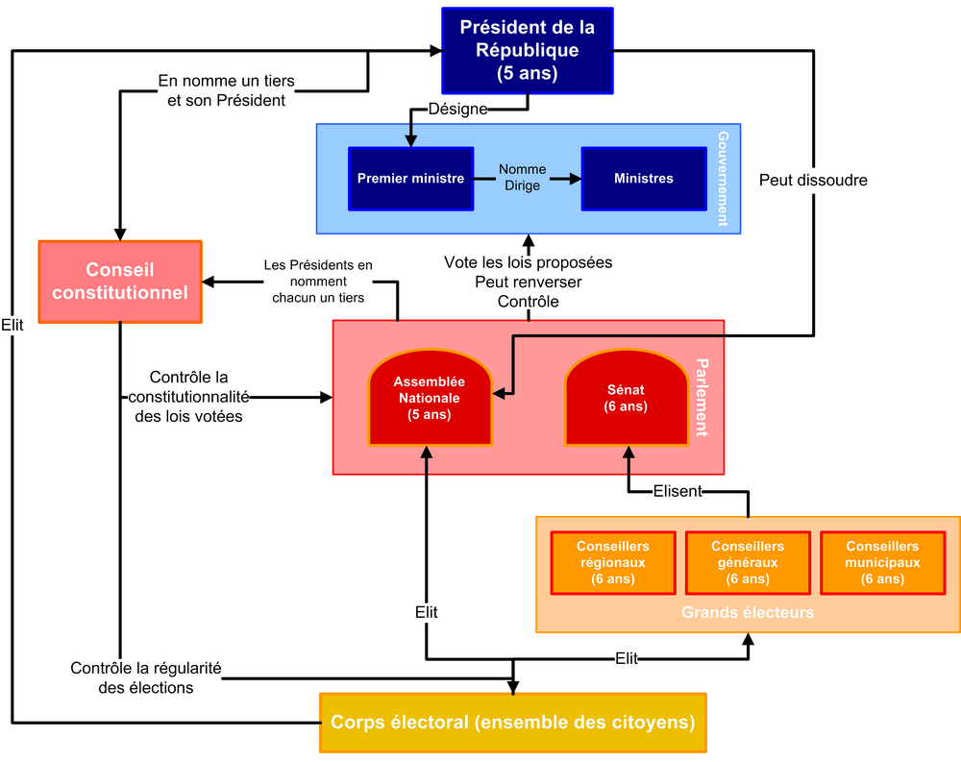
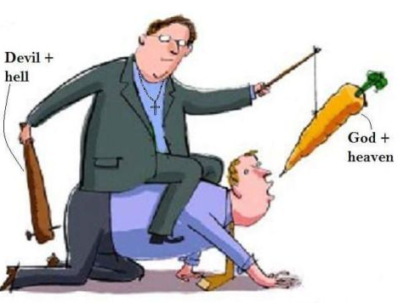
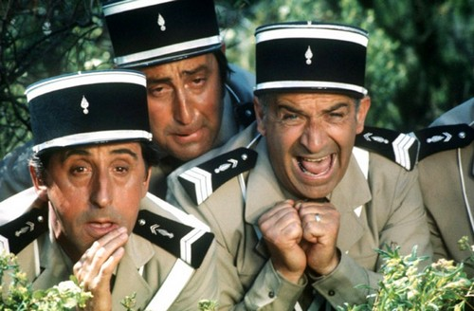
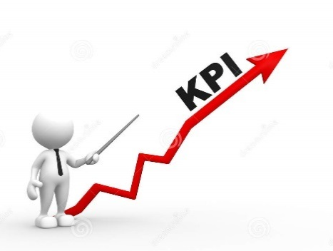

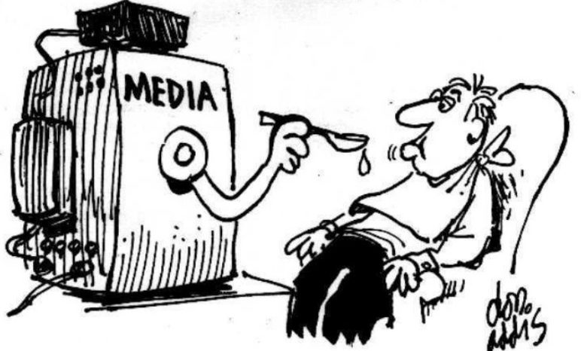
How to control such a complex system?
Performance management is one way for controlling behaviour beside:
Competition
Advertisement, Propaganda, Brainwashing
Threat, False flag
Concealment
Leaked secrets
Corruption
…
Direct control
Organize
Decide
Enforce…
Behaviour control
Influence
Encourage
Exite….

Slide 13
Increase complexity, collective intelligence
Goal
C4 > C3 > C2 > C1
C1
Management
C’2  C2
Direct control
Behaviour
control
C2
C2’
Organize
Decide
Enforce
Influence
Encourage
Excite
Deterministic
Operations
C3
+ C3’
C5
Operations
C5 > C3
Minds
Opportunistic
Effective action
Elevate Operations complexity
Environment
C4

Slide 14
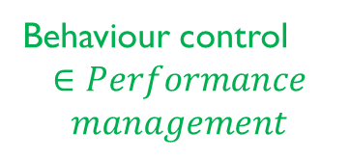
Enterprise control representation
5.Policy
Behaviour control
$$∈Performance$$
$$management$$
Environment
Recursion
Strategic directives
Resource Allocation and arbitration
4.Transformation
HR, Engineering
IT, Contracts, R&D
Finances
Organization
Marketing
Communication
…
Direct control
Requirement
Projects
3.Delivery
& monitoring
2.Coordination
1.Operations
Sales
Design
Source
Make
Deliver
en.wikipedia.org/wiki/Viable_system_model

Slide 15
Agenda
IT transformation
Enterprise control
Performance management
Use case

Slide 16
Complex system control
Behaviour
control
SS0
Direct
control
SS1
SS2
SS11
SS12
SS21
SS22

Slide 17
Local aspects: Behaviour propagation in sub-systems
SS0
KPIs
Excitation
Reaction
SS1
SS2
Reach performance target
with available means
Operations
& coordination
Fast loop
Excitation
Delivery &
monitoring
Transform itself to improve local performance
Reaction
Induce others’ transformation
to improve local performance
Policy
Transformation
Slow loop
KPIs
Excitation
Reaction
SS11

Slide 18
Global aspects: Overall Interactional Effectiveness
OIE
R * S * Q * OVA/OOE
Focus all enterprise functions on a global indicator
Seeking mission fulfilment
Social Responsibility
Speed
(Working Capital Need)
Quality
Overall Value Added
Overall Operating Expenses
Innovation
Sales
Design
Source
Make
Deliver

Slide 19
Global aspects: Overall Interactional Effectiveness
Enterprise
Policy
OIE
R * S * Q * OVA/OOE
Social Responsibility
Speed
(Working Capital Need)
Quality
Overall Value Added
Overall Operating Expenses
Transformation,
Delivery & monitoring
Coordination
Operations
Performance
Innovation
Sales
Design
Source
Make
Deliver
IT Delivery
& monitoring
R
S
Q
OVA
OOE
Performance
Change requests
IT Transformation
Transformation
Performance

Slide 20
Dynamic performance management
Policy
Transformation
Organizational
Performance
Potentiality
The reachable, desirable target
(transformation investment)
Critical for long term survival
A/P
C/P
Latent
Performance
Long term strategic gap
Conditions survival
Delivery & monitoring
Capability
Feasible performance target
With the current resources
A/C
Operational
Performance
Short term efficiency
Ability to leverage available resources
Coordination
Operations
Actuality
Current performance measure
en.wikipedia.org/wiki/Viable_system_model

Slide 21
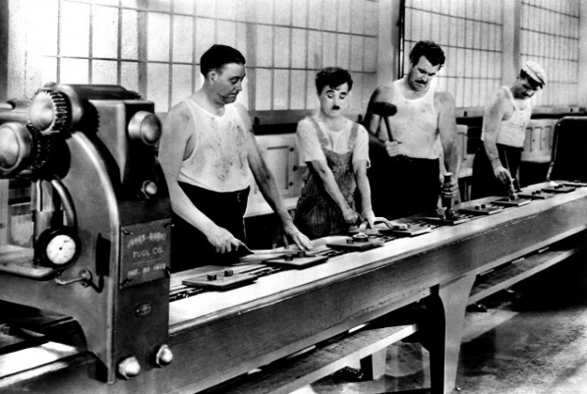
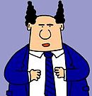
Example
We produce an average of 600 products a week
Our equipment has a full capacity of 20 products per hour
We operate 8 hours a day, 5 days a week
We have 2 equivalent machines that cannot be operated simultaneously
Actuality
Capability
Potentiality
Operational P. (A/C)
Latent P. (C/P)
Organ. P. (A/P)
600
800 (20*8*5)
6720 (20*24*7*2
75%
12%
9%

Slide 22
IT budgeting
Many formulas for guesstimating IT ROI and functional / projects budgets
  IT in industry hardly delivers tangible value, difficult to prove after implementation
OIE focuses IT on critical requirements
Potentiality = backlog of critical requirements
Capability = selected priority requirements for given resources
C/P = IT Latency for serving strategic objective
  Informed financial arbitration

Slide 23
Conflict resolution
Conflicts -> uneasiness, discomfort, complaints
PM as a likely cause,
  Compromises effective contribution to fulfil enterprise objectives
  Due to failed assumptions about local performance relevance
Need for continuous monitoring of arising conflicts
  and KPIs’ relevance

Slide 24
Agenda
IT transformation
Enterprise control
Performance management
Use case

Slide 25
Context
R&D department of a large company (2000 researchers)
Deployment of ELN software
Issues
  Slow and costly delivery of complex experimentation templates
  Sensitive relationships Business / IT / Software provider
  Researchers goals (IP protection) conflicts with project goal (leveraging shared knowledge)
Example for a simplistic metrics showing the bottom-up chain of responsibilities and flawed assumptions

Slide 26
Objective
Increase
Overall Added Value
Group Policy
Educated
guess…
Group transformation
Boost Innovation
Numerous, effective
inventions
Improve research productivity
Educated
guess…
Resource
allocation
R&D Policy
& transformation
Improve experimentation productivity
Share knowledge
Standardize experimentation
Resource
allocation
Leverage Information technology
R&D IT Policy
& transformation
Resource
allocation
Fast, cost effective
ELN Deployment
Contractor IT Delivery,
coordination and operations
Implement ELN
Fast, cost effective
ELN Deployment

Slide 27
User coverage KPI and responsibilities
Poor performance.
Will this target actually help boosting innovation?
Numerous, effective
inventions
Group Policy & transformation
Directives to R&D
R&D budget
R&D Policy & transformation
Potentiality
2000
Directives to IT
IT budget
Latency
Organisational
19%
4%
R&D IT Policy & transformation
Potentiality
380
ELN delivery budget
Latency
Organisational
R&D IT delivery & monitoring
135
36%
23%
Capability
Fast, cost effective
ELN Deployment
Operational
65%
Contractor operations
(VSM recursion)
Actuality
88

Slide 28
Conflict resolution
Share knowledge
Standardize experimentation
ELN full deployment justification
Improve experimentation productivity
Numerous, effective
inventions
Promote research sharing
Data rather process oriented
Protect individual IP
Experimentation freedom
Enable creativity
Researchers requirements
en.wikipedia.org/wiki/Evaporating_Cloud

Slide 29
Conclusion
IT continuous transformation
  Support enterprise ongoing transformation
  Leverage new technologies
IT performance management is an essential component in this process
  To focus efforts on enterprise goal / objectives
  To set IT budgets
Better understanding through system approach
  Complexity management, Behaviour control
  Overall Interactional Effectiveness
  Responsibility, Conflict resolution

Slide 30
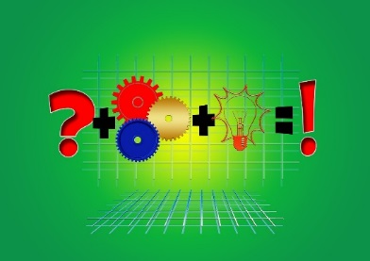

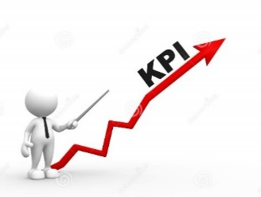

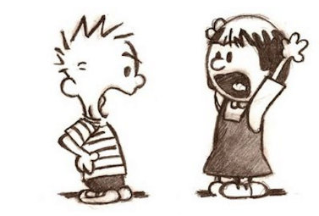
Questions?
Q
OVA
OOE
S
R
OIE
Transformation
Responsibility
Performance
Conflicts
Behaviour

